Slide 1


5G – Small Cell Deployment Training
U.S. Department of Labor - OSHA
Susan Harwood Grant
SH-99035-SH0

Slide 2
Acknowledgement
This material was produced under a 2020 Susan Harwood Grant (SH-99035-SH0) from the Occupational Safety and Health Administration (OSHA), U.S. Department of Labor. It does not necessarily reflect the views or policies of the U.S. Department of Labor, nor does mention of trade names, commercial products, or organizations imply endorsement by the U.S. Government.
After the completion of this course, please refer to your company policies and procedures.
natehome.com
Notes:
Acknowledge that funding for the development of this training and delivery of the training was provided by the Department of Labor through a Susan Harwood Grant.

Slide 3
Training Topic Sections
Section 1: Introduction to NATE and OSHA
Section 2: State of the Industry
Section 3: Potential Small Cell Hazards and Exposures
Section 4: Personal Protective Equipment (PPE)
Section 5: Pre-task Planning and Job Hazard Assessment
Section 6: Temporary Traffic Control
Section 7: Trenching and Excavation
Section 8: Small Cell Electrical Hazard Identification
natehome.com

Slide 4
Training Topic Sections (continued)
Section 9: Fiber Optics Safety Basics
Section 10: Working at Height
Section 11: Radio Frequency Hazards
Section 12: Confined Spaces
Section 13: Environmental Concerns
Section 14: The Challenges of Working Alone
natehome.com

Slide 5
Course Objectives
Section 1: Enhance students’ knowledge of the roles of OSHA and NATE.
Section 2: To provide a course overview video of small cell deployment and highlight the future small cell buildout projections.
Section 3: Enhance awareness and knowledge of potential small cell hazards and exposures.
Section 4: Provide baseline knowledge of common types of PPE utilized in small cell construction and maintenance.
Section 5: Enhance awareness in recognizing and documenting small cell hazards by applying control measures through pre-task planning and job hazard assessment(s).
natehome.com

Slide 6
Course Objectives (continued)
Section 6: Elevate awareness of traffic control and management processes related to work in the right-of-way (ROW) for small cell deployment and maintenance.
Section 7: Provide a basic understanding of safe trenching and excavation practices.
Section 8: Develop a basic understanding of potential electrical hazard identification and control measures.
Section 9: Discuss basic considerations for working safely with fiber optics.
Section 10: Enhance understanding of hazards associated with working at heights while working in a public ROW.
natehome.com

Slide 7
Course Objectives (continued)
Section 11: Understanding of radio frequency emissions, signage, use of a personal protection monitor, and control measures to ensure worker safety.
Section 12: Develop an understanding of various types of confined spaces and their impact on small deployment and maintenance.
Section 13: Create awareness of environmental hazards for small cell deployment and maintenance.
Section 14: Understand the safety and professional aspects of working in the vicinity of the general public and within the public right-of-way.
natehome.com

Slide 8
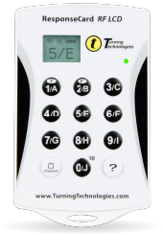
Turning Point Technology
In this training you will utilize Turning Point interactive response software.
You will be asked questions and receive real-time feedback with handheld mobile devices. Results are instantly displayed on the screen and collected in detailed reports to ensure all participants are accounted for.
natehome.com
Notes:
In this class students will utilize Turning Point interactive response software. This interactive software is presented at the end of each section to determine if they have learned the information presented.
Turning Point is very simple to use. You will present students with either a multiple choice, or true or false question. You will visibly see the question on the overhead. You will read the question to the students, (as you may have some students that have difficulties reading), and the possible correct answer. Using a transponder, that will be provided to them before class starts, they will choose what they believe to be the correct answer.
Once everyone in the class answers, you will close the voting and the correct answer will appear on the overhead along with the number of correct and incorrect answers. This will help your student in the learning process as you will receive instant feedback on their knowledge of the subject matter.

Slide 9
Pancake : Griddle : Hamburger?
Lettuce
Grill
Bun
Ketchup
natehome.com
Notes:
Answer: B (Grill)

Slide 10
What is your age?
18-24
25-34
35-44
45-54
55-64
65 and up
natehome.com

Slide 11
What is the size of your employer?
I don’t know
1-10 employees
11-50 employees
51-100 employees
More than 150 employees
natehome.com

Slide 12
What primary sector do you service?
Wireless
Municipalities
Regulatory
Public Safety
Electrical
Utilities
Real Estate Owner/Manager or Maintenance
natehome.com

Slide 13

Section 1
Introduction to NATE and OSHA

Slide 14
NATE and OSHA Topics
Introduction to NATE and OSHA
Importance of NATE and OSHA
Responsibilities of the employer under OSHA
Employee rights under OSHA
natehome.com

Slide 15
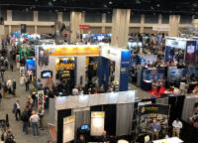
About NATE
Global Leader in industry safety and best practices for 26 years;
Voice of tower and communications infrastructure, construction, service, and maintenance industries; and
Diverse membership make-up consisting of over 970 member companies.
natehome.com
Notes:
Talk about the vital role NATE plays in the wireless and broadcast infrastructure industries.
Share their personal connection to NATE and how they have worked with NATE through the years.
Mission Statement:
Pursue, formulate and adhere to uniform standards of safety for tower personnel.
Educate the general public, applicable government agencies and clients on continued progress toward safer standards within the industry.
Keep all members informed of issues relevant to the industry.
Provide a unified voice for tower erection, service and maintenance companies.
Facilitate effective safety training for the industry.

Slide 16

About OSHA
On December 29, 1970, President Nixon signed the Occupational Safety and Health Act of 1970 (OSH Act) into law. The OSH Act created the Occupational Safety and Health Administration (OSHA) to ensure safe and healthful working conditions for working men and women by setting and enforcing standards and by providing training, outreach, education, and assistance.
natehome.com
Notes:
Talk about OSHA being established during Nixon Administration after Congress passed the OSH Act.

Slide 17
What Does OSHA Do?
Works with employers and employees to reduce workplace hazards through partnerships and alliances;
Introduces new or improves upon existing safety and health programs;
Utilizes consensus standards through an agreement with ANSI;
Educates on safety and health rules that are designed to protect workers;
Enforces the rules through inspection and citations;
Monitors job-related injuries and illnesses through electronic records and reporting; and
Conducts a variety of inspections to include: accidents, fatalities, complaints, and programmed inspections.
natehome.com
Notes:
Note that OSHA (the Occupational Safety and Health Administration) is a regulatory agency of the federal government that has been established to ensure that the Law is adhered to by regulating employers. This is accomplished by developing standards consistent with the law, educating employers and employees and enforcing the standards on employers.

Slide 18
Workers Have the Right to:
Safe and healthful working conditions;
File a confidential complaint with OSHA in regards to safety and/or health concerns in the workplace;
Review records of work-related injuries and illnesses;
Receive training regarding the OSHA standards that apply to their workplace;
Report any injury or illness without retaliation or discrimination;
Obtain copies of test results done to find hazards in the workplace; and
Obtain copies of their medical records.
Source: OSHA 3021-09R 2011, www.osha.gov/workers.html
natehome.com
Notes:
Describe this protection in simple terms or by example. This provision advocates for workers who report complaints which provide a hazard in the environment in which they work. The protection protects them from each of the bulleted points.

Slide 19
Employers Must:
Provide a workplace free from recognized hazards and comply with standards, rules and regulations issued under the OSH Act;
Eliminate or reduce hazards by making feasible changes in working conditions;
Not discriminate against employees who exercise their rights under the Act;
Inform employees of hazards through training, labels, alarms, etc.;
Train employees in a language/vocabulary employees can understand; and
Keep accurate records of work-related injuries and illnesses.
Source: OSHA 3021-09R 2011, www.osha.gov/workers
natehome.com
Notes:
Point out the responsibilities employers have to protect their employees.

Slide 20
OSHA Whistleblower Protection
Visit osha.gov/workers or call 800-321-OSHA;
Be prepared to provide specific details regarding your company and the type of hazard or discrimination being reported;
Keep a confidential record of all details; and
Once a complaint is filed or reported, an investigation is normally warranted (see criteria on website).
Source: OSHA 3021-09R 2011, www.osha.gov/workers
natehome.com
Notes:
May outline the Whistleblower Protection protocol for employees to follow with OSHA. The website and phone number should be emphasized on this slide to educate workers on how to report this information.
Being fired or laid off
Being blacklisted
Demotion
Being denied promotion or overtime
Pay reduction
Reassignment
Benefits denial

Slide 21
Section 1
Review Questions

Slide 22
What OSHA whistleblower statutes are designed to provide employees the freedom to report violations and protect employees from the following acts of retribution?
Being blacklisted
Demotion
Being denied promotion or overtime
Pay reduction
All of the above
natehome.com
Notes:
Answer: E (All of the above)

Slide 23
Employees can report hazards and violations to OSHA through which mediums?
By phone: 800-321-OSHA
By website: osha.gov/workers
All of the above
None of the above
natehome.com
Notes:
Answer: C (All of the above)

Slide 24
Section 2
State of the Industry

Slide 25
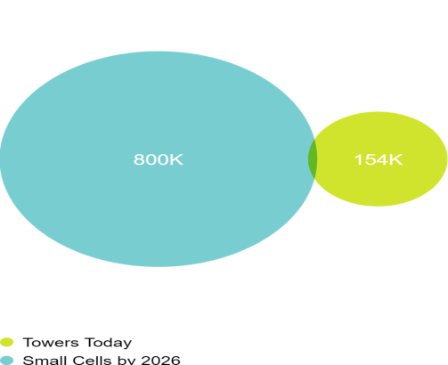

Industry Data – Small Cells
natehome.com
Notes:
According to trade association CTIA, projections indicate that there will be 800,000 small cells installed on infrastructure by 2026.
* (CTIA: Wireless Industry Infographics Library – https://www.ctia.org/the-wireless-industry/infographics-library)

Slide 26

Future Infrastructure Deployments
natehome.com
Notes:
According to trade association CTIA, 80% of future infrastructure deployments will be small cells.
* (CTIA: Wireless Industry Infographics Library – https://www.ctia.org/the-wireless-industry/infographics-library)

Slide 27

Small Cell Deployment Support
natehome.com
Notes:
According to trade association CTIA, 7 out of every 10 Americans support MORE small cell deployments.
* (CTIA: Wireless Industry Infographics Library – https://www.ctia.org/the-wireless-industry/infographics-library)

Slide 28

Small Business Leaders
of small business leaders support more small cell deployments
natehome.com
Notes:
According to trade association CTIA, 80% of small business leader support MORE small cell deployments.
* (CTIA: Wireless Industry Infographics Library – https://www.ctia.org/the-wireless-industry/infographics-library)

Slide 29

5G Economy
natehome.com
Notes:
According to trade association CTIA, 5G will spur $500 billion in economic growth.
* (CTIA: Wireless Industry Infographics Library – https://www.ctia.org/the-wireless-industry/infographics-library)

Slide 30

5G Investment
natehome.com
Notes:
According to trade association CTIA, 5G will drive $275 billion in new investment.
* (CTIA: Wireless Industry Infographics Library – https://www.ctia.org/the-wireless-industry/infographics-library)

Slide 31

5G Job Creation
natehome.com
Notes:
According to trade association CTIA, 5G wireless technology will create 3 Million new jobs across all sectors.
* (CTIA: Wireless Industry Infographics Library – https://www.ctia.org/the-wireless-industry/infographics-library)

Slide 32

What Consumers Would Give up for Their Smart Phone!
Chocolate
TV
Coffee
natehome.com
Notes:
According to trade association CTIA, consumers would give up luxuries (and necessities) like chocolate, TV and coffee before they gave up their smart phone!
* (CTIA: Wireless Industry Infographics Library – https://www.ctia.org/the-wireless-industry/infographics-library)

Slide 33

What is a Small Cell
  What is a Small Cell?
natehome.com
Notes:
#ClimberConnection Video - https://www.youtube.com/watch?v=9A0EzNGdfzw

Slide 34
Section 3
Potential Small Cell Hazards and Exposures

Slide 35
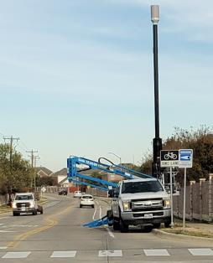
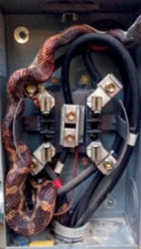
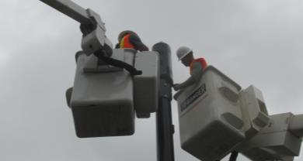
Potential Small Cell Hazards and Exposures
natehome.com
Notes:
What hazards do you see in these photos:
Some good points to discuss:
Wildlife
Spatial awareness when multiple crews on site
Fall Protection
Swing Radius on booms
Lack of Traffic Control

Slide 36
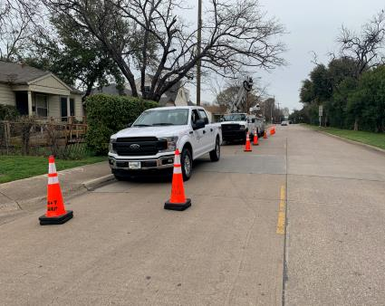
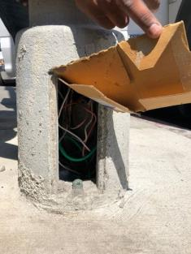

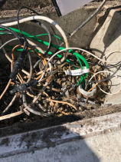
Potential Small Cell Hazards and Exposures (continued)
natehome.com
Notes:
Additional topics:
Overhead obstacles
Traffic Control
Pedestrian Traffic
Improper Wiring
Unprotected enclosures

Slide 37
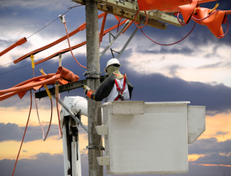
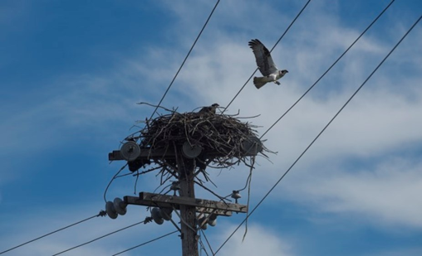
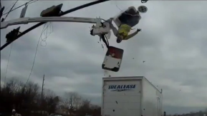
Additional Risks
natehome.com
Notes:
Additional Items:
Protected Birds/Wildlife
Electrical Exposure
Vehicle Risks
Fall Protection

Slide 38
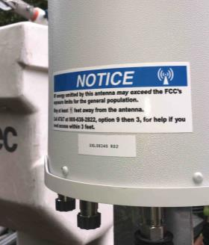
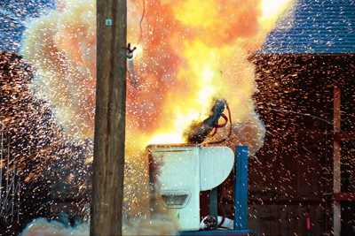
RF Exposure/Electrocution/ARC Flash
natehome.com
Notes:
Additional Notes
RF Exposure
Electrocution/ARC Flash

Slide 39
Section 3
Review Questions

Slide 40
Which is a factor beyond the employee’s control that can be considered a hazard on a small cell site?
Wildlife
Foot traffic
Vehicular traffic
All of the above
natehome.com
Notes:
Answer: D (All of the Above)

Slide 41
What type of traffic appears to be at risk when working in the ROW?
Marine traffic
Air traffic
Subterranean
Vehicle and pedestrian traffic
natehome.com
Notes:
Answer: D (Both vehicle and pedestrian traffic)

Slide 42
Section 4
Personal Protective Equipment (PPE)

Slide 43
Examples of PPE
Body Part | Protection
Head | Hard hats
Eye | Safety glasses/goggles
Hands and arms | Gloves
Feet | Safety shoes/boots
Bodies | Protective clothing
natehome.com
Notes:
Per 29 CFR 1910.132 employers are required to determine what hazards are likely to exist in the workplace which would necessitate the use of PPE.
Employers are responsible for:
Selecting PPE
Require PPE use of its employees
Communicate PPE decisions to employees
Select proper fitting PPE
Train employees on the use of PPE, and
Pay for PPE, with some exceptions. Non specialty safety shoes for example as long as the employer allows the shoe to be worn off the job.
NOTE:
Respirators and electrical protective equipment (gloves, sleeves, blankets, etc.) are also considered PPE. However, because OSHA has specific requirements for them, they are not discussed here.

Slide 44
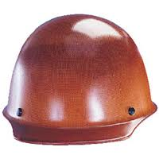
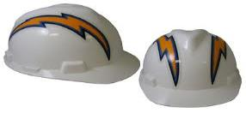
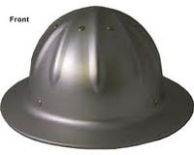
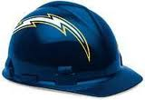
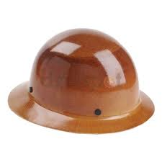
Hard Hats
A hard hat is an important part of your PPE.
It protects your head from potentially dangerous hazards.
Any time there is a potential for a head injury a hard hat must be worn.
Supervisory management may require the use of the hard hat any time they believe a potential hazard may exist.
natehome.com
Notes:
1926.100, 1926.100(a)
Employees working in areas where there is a possible danger of head injury from impact, or from falling or flying objects, or from electrical shock and burns, shall be protected by protective helmets.
OSHA incorporates by reference Z89.1-2009 American National Standard for Industrial Head Protection.

Slide 45
When to Use Hard Hats
When conditions can result in a head injury from falling objects, moving objects, or striking an object.
When it is possible to accidentally come in contact with an electrically energized object.
When performing all kinds of work on and around poles, such as maintenance, testing and repair.
While ascending or descending ladders.
Working in the vicinity of construction apparatus or equipment.
Working on ground level when work is going on overhead.
natehome.com

Slide 46
When to Use Hard Hats (continued)
Working in any area or enclosure where headroom is insufficient.
Working at all sites where construction work is in progress.
In any posted area requiring hard hats, or when otherwise required by law.
While walking/working alongside major roads/highways to protect against flying objects.
While loading/unloading or moving supplies/materials in or out of vehicles.
Working aloft in a bucket truck.
When there is a potential for head injury.
natehome.com

Slide 47
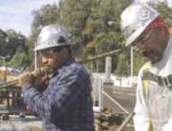
Classes of Hard Hats – Class G
Class G (General)
  General service (e.g., building construction, shipbuilding, lumbering, and manufacturing).
  Good impact protection.
  Limited voltage protection (proof-tested at 2,200 volts).
Source: OSHA
natehome.com
Notes:
https://www.osha.gov/Publications/osha3151.html
“There are many types of hard hats available in the marketplace today. In addition to selecting protective headgear that meets ANSI standard requirements, employers should ensure that employees wear hard hats that provide appropriate protection against potential workplace hazards. It is important for employers to understand all potential hazards when making this selection, including electrical hazards. This can be done through a comprehensive hazard analysis and an awareness of the different types of protective headgear available.”
(OSHA Publication 3151-12R, 2003)
Class G hard hats are intended for general service use, such as building construction, shipbuilding, lumbering, and manufacturing. Class G hard hats provide good impact protection, but limited voltage protection (proof-tested at 2,200 volts).

Slide 48
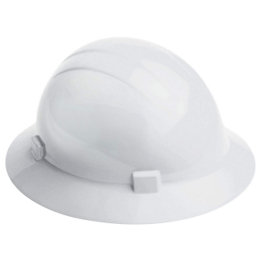
Classes of Hard Hats – Class E
Class E (Electrical)
  Electrical work.
  Protect against falling objects.
  Protect against high-voltage shock/burns (proof-tested at 20,000 volts).
natehome.com
Notes:
Class E hard hats are designed for electrical/utility work. They protect against falling objects and provide protection against conductors with higher voltage levels (proof-tested at 20,000 volts).
The class E hard hat is most likely the one that most employers will select for small cell construction.

Slide 49

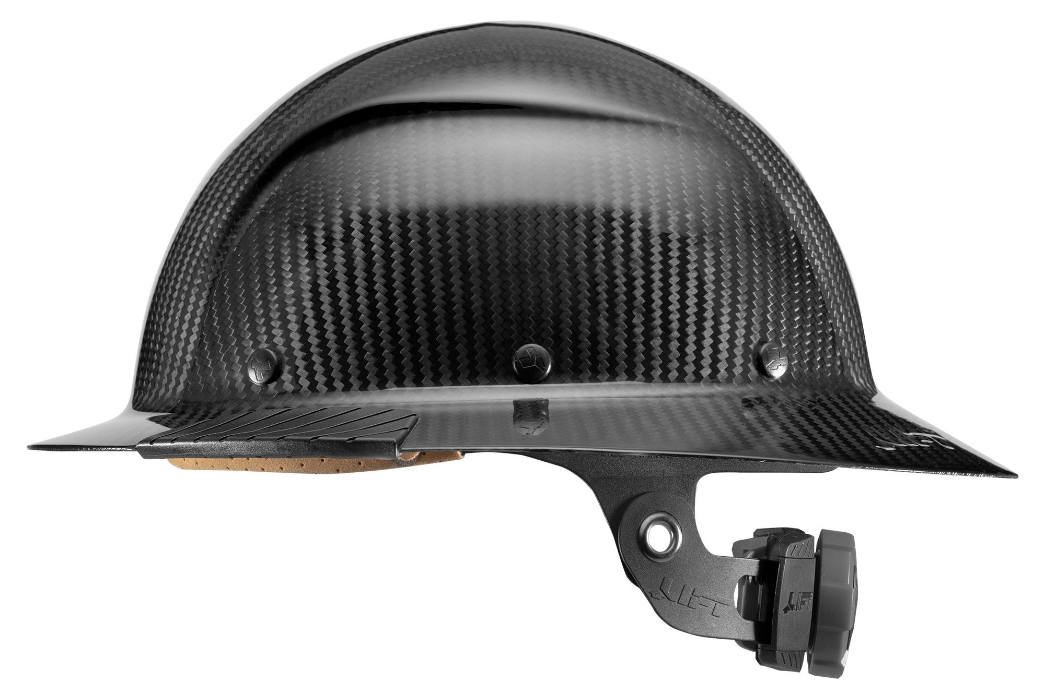
Classes of Hard Hats – Class C
Class C (Conductive)
  Designed for comfort and breathability.
  Does not protect against electrical hazards.
natehome.com
Notes:
Class C hard hats do not provide any protection against electrical hazards.

Slide 50
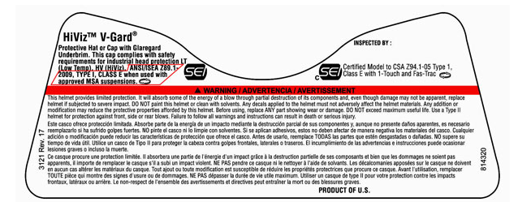
Determining the Hard Hat Class
Check the labels to determine the class of hard hat.
natehome.com

Slide 51
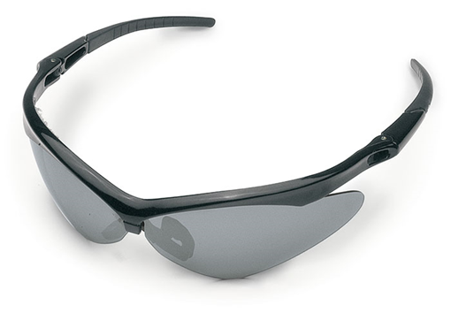
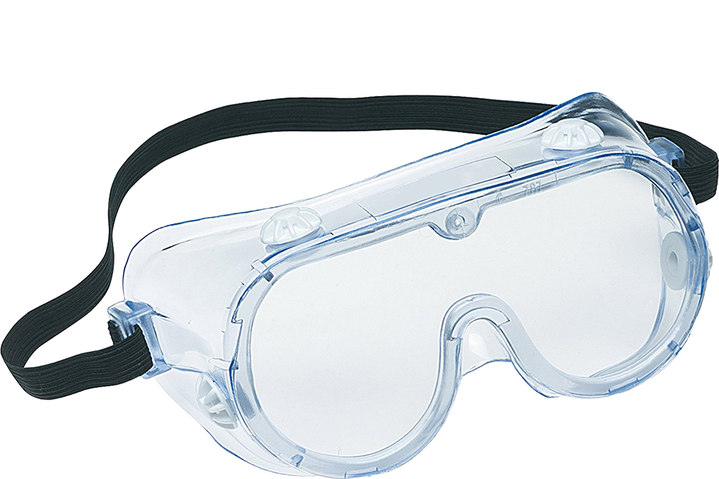

Eye Protection
Types of Eye Protection
Protective Eyewear
Splash Proof Goggles
Impact Type Safety Goggles
Face Shield
Wrap around protective eyewear must be worn:
Whenever working with hand tools.
While walking/working alongside roads/highways to protect against flying objects.
Impact type safety goggles must be worn:
Overhead work with loose material.
Using compressed air.
Whenever in close proximity to others performing above operations.
Corrective lenses and ordinary glasses do not provide the required protection! Protective eye-wear shall conform to ANSI Z87.
natehome.com
Notes:
ANSI Z87.1-2010 American National Standard Practice for Occupational and Educational Eye and Face Protection is in corporate by reference into 29 CFR 1926.102.
Workers may balk at wearing safety glasses in the right of way, wondering why they have to wear them. It is not unreasonable to assume that road debris can become airborne.

Slide 52
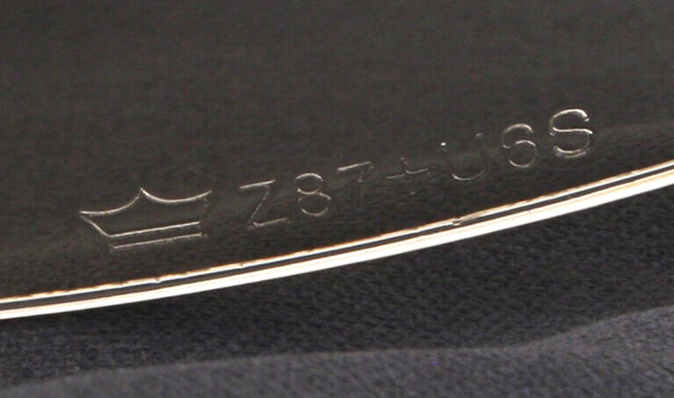
Eye Protection (continued)
    When to Use Eye Protection
    When exposed to eye or face hazards from flying particles, liquid chemicals, acids, caustic liquids, chemical gas/vapors, light radiation or when using tools.
    When performing operations requiring special eye protection, like goggles.
Reasons for Eye Protection
Eye protection is worn to prevent eye injury due to flying objects, particles,
or splashes.
NOTE: All safety markings for ANSI Z87.1 safety eyewear typically have Z87 stated on the frame or lenses. This marking requirement includes goggles and face shields as well as safety glasses.
natehome.com
Notes:
1926.102(a)(5) – Protectors shall meet the following minimum requirements:
They shall provide adequate protection against the particular hazards for which they are designed.
They shall be reasonably comfortable when worn under the designated conditions.
They shall fit snugly and shall not unduly interfere with the movements of the wearer.
They shall be durable.
They shall be capable of being disinfected.
They shall be easily cleanable.
See OSHA Publication 3151, Assessing the Need for Personal Protective Equipment: A Guide for Small Business Employers.

Slide 53



Hand Protection
Gloves are worn to protect the hands from scrapes, cuts, bruises, electrical hazards, and chemicals that can irritate skin.
Kinds of hand protection and when they should be used:
Leather Work Gloves are used for general hand protection during work, such as handling ladders and line and/or winch.
Cut Resistant (CR) Gloves resist slicing, cutting, and puncture while removing cable sheath.
Insulating and Leather Protector Gloves protect against electric shock. Use when electrical hazards are present. Leather protectors provide protection from punctures and scraping from rough surfaces.
natehome.com
Notes:
If possible, have multiple styles of gloves and allow students to try them.
Explain that no glove can do everything.
Typically, the more protection, the less dexterity.

Slide 54
Safety Footwear
Your safety footwear protects your feet and ankles from injury.
Characteristics of Safety Footwear
Footwear that covers the entire foot and ankle with leather uppers or comparable materials.
Must meet American National Standards Institute (ANSI) Z41, 1999 or American Society for Testing and Materials (ASTM) F2413-05 design criteria for toe protection.
Well-defined heel with a minimum ½ inch and maximum 1½ inches in height measured from the sole of the boot.
Steel shank is recommended for arch support.
Selection of a slip resistant sole and heel is recommended.
natehome.com
Notes:
Demonstrate each point made by using a pair of safety footwear.

Slide 55
When and Why to Wear Safety Footwear
To protect the feet and ankles from injury.
To prevent punctures, twisted ankles or foot/leg sprains, and slips/trips/falls:
  Look ahead to identify a path clear of hazards.
  Before stepping down or as you walk, identify the condition of the ground.
To protect you against impacts of up to 75 pounds and crushing forces of up to 2,500 pounds.
When routinely handling materials, tools or equipment weighing 30 pounds or more, e.g. ladders, cable reels, etc. Use toe protected safety footwear meeting ANSI Z41 or ASTM F2413-05 design criteria. Either standard is acceptable.
When climbing rung type ladders (extension, fixed, etc.), consider utilizing footwear that covers the ankle and has a well-defined heel at least ½ inch in height measured from the sole. Selection of a slip resistant sole and heel is recommended.
natehome.com
Notes:
For bullet point 4, employers may set a weight requirement requiring workers to wear safety toe footwear to protect against impact.

Slide 56
Protective Clothing
General Clothing
Wear comfortable clothes that fit well (not loose).
Do not wear jewelry, metal watch bands, or rings.
Wear clothes suitable for the type of weather.
Shirts
Wear long-sleeved shirts, and do not roll up the shirt sleeves.
Leg Wear
Wear long-legged pants, and keep the legs of the pants well down over the ankles.
natehome.com
Notes:
Give examples of comfortable and well fitting protective clothing. Demonstrate each point as it is discussed.

Slide 57
Retro-reflective Clothing
Retro-reflective clothing is necessary when working in the right-of-way (ROW) or in the vicinity of moving equipment.
2 Main classes of retro-reflective clothing for ROW use
  Class 2 – is the minimum requirement for working in the right-of-way during daylight hours.
  Class 3 – recommended for high-speed roadways and nighttime work.
3 Types of garments
  Type O (Off-road)
  Type R (Roadway)
  Type P (Fire, Police, EMS)
Small Cell workers typically wear a Type R, Class 2 or 3 garment
natehome.com
Notes:
The class is determined by a combination of the background material and retroreflective material. The more of each, the higher the class.

Slide 58
When to Wear Retro-reflective Clothing
Anytime when working in a right-of-way (ROW).
When performing duties as a flagger.
Whenever working near moving equipment.
natehome.com
Notes:
The Manual on Uniform Traffic Control Devices (MUTCD) requires the use of ANSI 107-2004 apparel for workers who are within the right-of-way when exposed either to traffic (vehicles using the highway for purposes of travel) or to work vehicles and construction equipment MUTCD 6D.03.4.

Slide 59
Section 4
Review Questions

Slide 60
What hard hat class must be worn when working near power lines over 2,200 volts?
Class G
Class C
Class E
Class V
natehome.com
Notes:
Answer: C (Class E)

Slide 61
Who must provide and pay for PPE?
The worker
OSHA
The employer
Your significant other
natehome.com
Notes:
Answer: C (The employer)

Slide 62
Section 5
Pre-task Planning and Job Hazard Assessment

Slide 63
Pre-task Planning and Job Hazard Assessment
This section is designed to enhance awareness of hazards associated with construction and maintenance of small cell networks. A thorough process to define work scope, recognize and document hazards, and develop mitigation measures through pre-task planning and job hazard assessment is the foundation of safe work.
natehome.com
Notes:
This slide is to briefly discuss what Section 5 is all about. Pre-task planning and a job hazard assessment is a process performed by a work crew to identify and evaluate workplace hazards with the goal of eliminating or controlling them. Before the commencement of work activities, hazards present on the job site must be clearly identified, documented and discussed to successfully limit the employee exposures to those hazards. Pre-task planning and a job hazard assessment has been proven to be excellent tools to identify and evaluate hazards in the workplace.

Slide 64
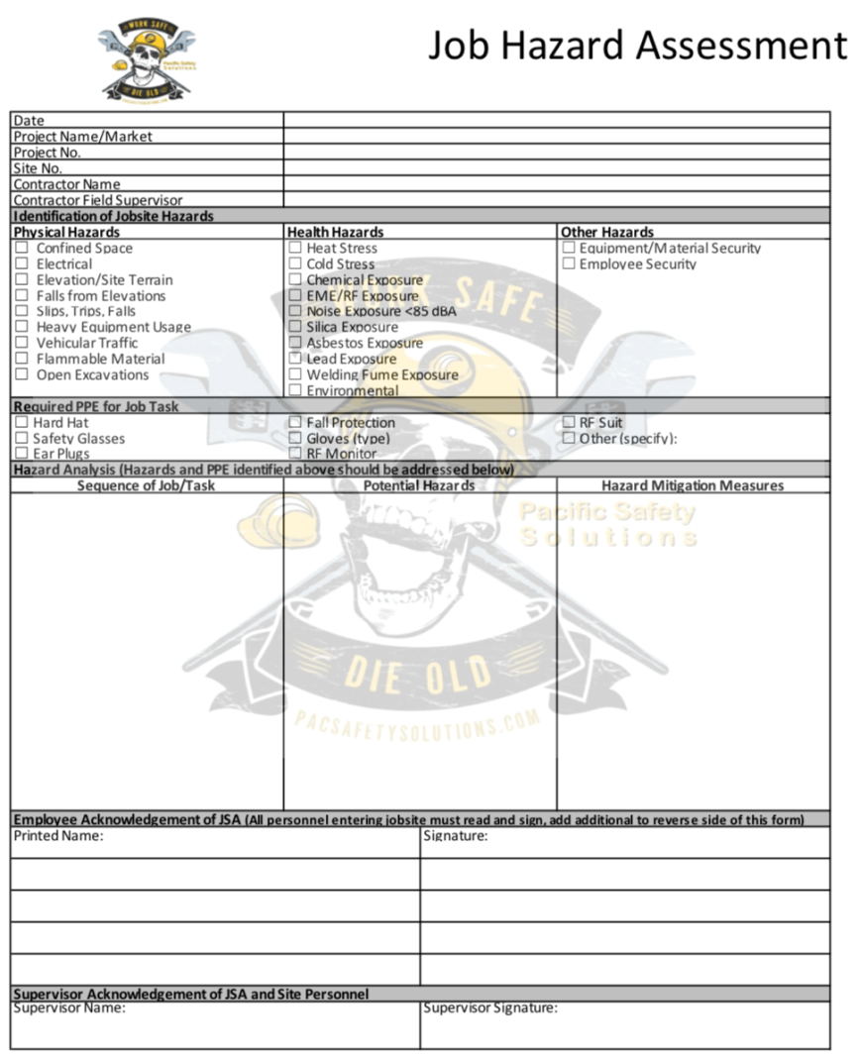
Job Hazard Assessment (JHA)
A Job Hazard Assessment must be conducted to address the potential hazards and methods to mitigate those hazards.
A hazard assessment must be updated daily or whenever the tasks, hazards, personnel change during the construction and maintenance processes.
natehome.com
Notes:
This slide deals with assessing the hazards associated with the overall scope of work. Remember, the scope of work is broken down into tasks. The tasks are broken down into steps. With the steps identified, what are the hazards associated with each step? Once the hazards are identified, control measures can be put into place.
Use a quick general example for a small cell site the scope of work is for an antenna and line crew to upgrade an existing site with new technologies. The scope of work can be broken down into individual steps such as but not limited to the following:
1. Working off ladders to reach the equipment
2. Staging material
3. Manually handling material
4. Use of a bucket truck to position equipment/materials onto a light pole
5. Replacing coax for the new technology
Use the step of replacing coax for the new technology to identify the tasks associated with that step.
The crew will be replacing coax in the existing cable tray. The cable tray runs along an unprotected edge, which is below 39”. The crew will be working within 15’ of this unprotected edge. The hazard for the crew while working on the cable tray is falling. The control measure is to set up a temporary guardrail along the unprotected edge to control the exposure of the crew members to a fall.
As it relates to updating the hazard assessment, this happens when an unidentified task appears on the job and this unidentified task was not addressed in the initial hazard assessment.
For example: The customer shows up with 12 batteries and needs help moving them into the shelter. This new task was not addressed at the beginning of the job and now presents a new set of hazards which need to be identified and controlled.

Slide 65
Job Hazard Assessment (continued)
A JHA is used to communicate the job tasks, hazards of the work tasks and control measures to:
  Crewmembers
  Subcontractors
  Customers
  Inspectors
The JHA must be reviewed by affected employees:
  Before commencement of work each day.
  When subcontractor arrives.
  When inspector arrives.
  When customer representative arrives.
  When conditions change.
  When work conditions deviate from the original scope.
  When an unidentified hazard surfaces.
natehome.com
Notes:
This slide shows what the purpose of a job hazard assessment is for, who is to review it and when it needs to be reviewed.
Here is where you will summarize the JHA. This is where you state the JHA is to be used as a tool in order to identify hazards associated with tasks and to put control measures in place to prevent injury and illness to all affected parties on site. The JHA is to be reviewed by all affected parties prior to them working. If the unidentified hazard surfaces it’s the role of the competent person to identify that, communicate the unidentified hazard to affected parties and document it on the JHA.

Slide 66
Scope of Work
The scope of work is broken down into specific tasks, materials, required equipment, and tools.
As each component is identified, lists can be made of the known and possible hazards and exposures associated with each respective task.
natehome.com
Notes:
This slide deals with the overall scope of work the crew will perform for the day. The scope of work needs to be broken down into tasks.
Break the job down into steps. Each of the steps of a job should accomplish some major task. The task will consist of a set of movements. Look at the first set of movements used to perform a task, and then determine the next logical set of movements. For example, the job might be to move a box from a conveyor in the receiving area to a shelf in the storage area. How does that break down into job steps? Picking up the box from the conveyor and putting it on a hand truck is one logical set of movements, so it’s one job step. Everything related to that one logical set of movements is part of that job step.
The next logical set of movements might be pushing the loaded hand truck to the storeroom. Removing the boxes from the truck and placing them on the shelf is another logical set of movements. And finally, returning the hand truck to the receiving area might be the final step in this type of job.
Be sure to list ALL the steps in a job. Some steps might not be done each time, such as checking the casters on a hand truck, for example. However, that task is a part of the job as a whole and should be listed and analyzed.

Slide 67
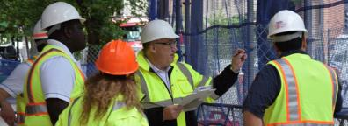
Pre-Job Meeting
There should be an initial meeting between as many of the involved parties as possible and may include:
  Building owner(s)
  Engineer
  General contractor and lower tier sub-contractor(s)
  Municipality
  Utility
In this initial meeting, the attendees shall designate and/or verify each party’s role and responsibilities.
natehome.com
Notes:
This slide deals with meeting all parties involved with the job. The pre-job meeting should include a coordinated effort between facility owners, structural engineers, contractors and/or technicians to assist in controlling the hazards associated with fall hazards, structural and facilitating proper planning.
Sometimes the structural engineers may not be available, but they will review the construction drawings to determine if the roof/building is strong enough to support the new equipment, (for example steel platform) .
Meeting with the building owners is important because this is where overall planning for the job is discussed. This includes but not limited to the following:
Access – How will the crew access the rooftop? Can the crew use the main elevator or does the crew have to use the freight elevator? Does the crew need to be escorted onto the roof each day?
Work hours – What are the hours of operation? Some building owners have specific hours of operation for the crew so that the work does not disrupt the tenants. Some of the tenants can be occupants of a hotel or a business.
Special requests – Parking for the crew. Are there dedicated parking stalls to use?
Emergencies – What is the protocol for an emergency? How will the crew be notified in case there is an emergency?
These are just some examples of many on why the building owner needs to be involved in this meeting.
The reason for the general contractors and lower tier subcontractors to be involved in the meeting is to go over the general scope of work to determine the schedule as well as to address the hazards associated with the scope of work. This meeting can determine if sky lights need to be covered/barricaded. If the use of a warning line system needs to be used. Is there a need to install temporary guardrails? Will the use of a fall restraint system be required?
The meeting is vital for planning safety into the job. Get safety involved on the front end in order to plan appropriately. Remember the 6 P’s – Proper, Planning, Prevents, Piss, Poor, Performance.
These are just some examples of many on why the building owner needs to be involved in this meeting.

Slide 68
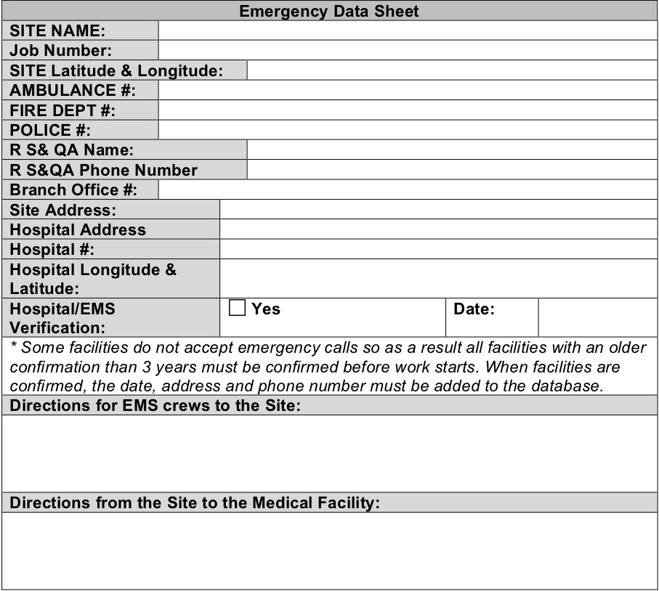
Emergency Information
The competent person should ensure emergency information is readily accessible.
All information should be verified prior to the commencement of work.
natehome.com
Notes:
This slide deals with the necessary emergency information required on a telecom jobsite. Briefly go over the imbedded emergency data sheet to identify the minimum components of the emergency information.
Additionally, discuss the importance for having the emergency information, which includes but is not limited to the following reasons:
Crewmembers know who to call in case of an emergency.
In the case of an injured crewmember, they know where the closest hospital is or the closest occupational clinic is located.
They have the jobsite address or latitude/longitude in case they need to coordinate with EMS.
Explain there is an industry tool on Wireless Estimator that can assist in developing an Emergency Action Plan, (EAP) which is essentially the required emergency information for the site.

Slide 69

Job Hazard Assessment Form
natehome.com
Notes:
This slide shows what a general job hazard assessment is comprised of. Briefly go over the imbedded job hazard assessment. You already covered the general job hazard assessment earlier so this is just a review. Keep in mind you will be covering this in more detail in the coming slides.

Slide 70
Section 5 Activity
"The Mouse Trap”

Slide 71
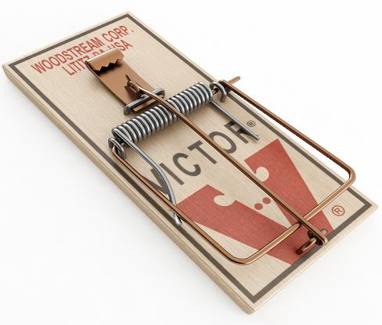
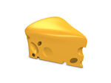

Build a Mouse Trap
Base
Bait Holder
Kill Bar
Trigger
natehome.com
Notes:
Have the group perform a JHA on baiting a mouse trap.
The task is to “bait” the mouse trap, not set and place the trap. Listen to all of the responses prior to asking “what was the job task?”
The key issues you are looking for is that they identify the hazards such as the lacerated edges on the bait holder and the possible biological infection from hanta virus from placing the trap in areas where there are mouse droppings.
Give the group 10 minutes to complete this exercise.
Click on the icon in the top right corner to activate the timer.

Slide 72
Section 6
Temporary Traffic Control

Slide 73
Traffic Control Plan
The Traffic Control Plan (TCP) is the use of traffic control devices to adequately safeguard and protect employees, pedestrians, motorists, and equipment.
All TCPs must follow jurisdictional requirements and comply with both local and state traffic laws.
TCP must be established prior to the commencement of work and must remain in place until after you have finished the work. Work hours defined within the TCP or based on jurisdictional or local city requirements.
Ensure trained personnel are executing the plan onsite including all OSHA requirements.
In addition to a TCP utilize a Job Hazard Analysis (JHA) to help establish a safe work area and emergency safety plan.
natehome.com
Notes:
Traffic control greatly reduces worker risk and the public.
Workers must always wear high visibility safety apparel with reflective materials.

Slide 74
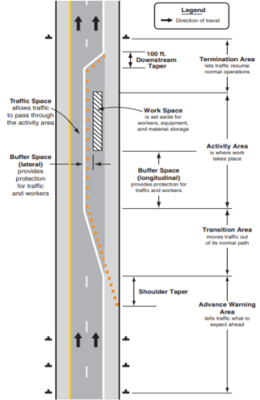
TCP Fundamentals
Road user and worker safety in temporary traffic control zones is critically important.
Plans should provide safety for drivers, bicyclists, pedestrians, and workers.
Road user movement should be inhibited as little as practical.
Drivers, bicyclists, and pedestrians should be guided in a clear and positive manner while approaching and traversing temporary traffic control zones.
natehome.com
Notes:
Consist of four main areas: Advance Warning, Transition, Activity, Termination.
Basics of Traffic Control is to get the attention of road users, convey a clear and simple meaning, command respect, and to give adequate time for a proper response.

Slide 75
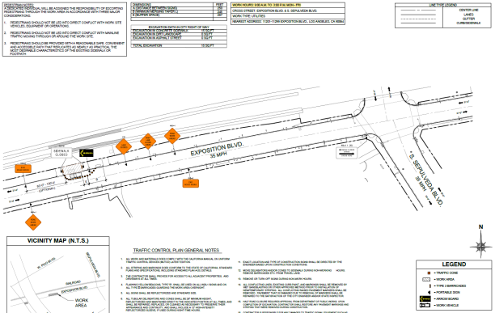
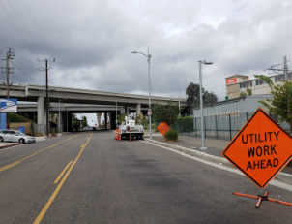
TCP Example
Ensure all safety signage and traffic channelizing devices are properly placed per TCP.
natehome.com
Notes:
Signs should be placed lower to the ground and mounted differently than typical road signs to improve recognition. Signs should not be lower than 1ft above the ground.
*Note the highlighted hours as defined by the jurisdiction of 9am to 3pm Mon-Fri. These hours have to be adhered to closely.

Slide 76
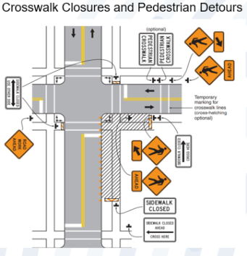
Pedestrian Traffic Considerations
Determine whether pedestrian flow will affect work zone.
Positive guidance.
Crossing point to crossing point.
ADA compliant.
Not exposed to traffic hazards.
Walk the site.
Does not expose to overhead hazards (dropped objects).
natehome.com
Notes:
It is encouraged to walk the path to ensure that the pedestrian walkway is clear and has safe crossing points.
* ADA Compliant- can a wheelchair access it and is there a safe crossing zone for a wheelchair?

Slide 77


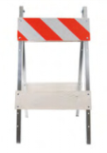


TCP Components
Advanced warning signs such as work zone signs and guide signs.
Barricades and cones for guiding and channeling.
natehome.com
Notes:
Cones are limited to 36” in height, but may be shorter per the MUTCD. Taller cones or tubular markers should be used to improve visibility and command the appropriate response from drivers.

Slide 78
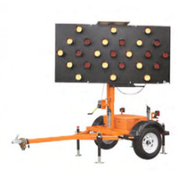
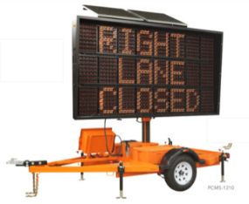
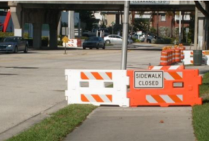

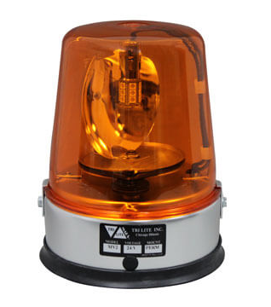
TCP Components (continued)
Other warning devices such as rotating beacons, strobe lights, arrow boards, flaggers, pedestrian barricades, and vehicle-mounted crash attenuator/cushions – the work vehicle with rotating beacon/strobe lights, when placed properly, can also be used to protect the work area.
natehome.com
Notes:
Use of arrow panels will improve visibility and the likelihood of drivers responding in a safe and timely manner.
Use of warning lights on vehicles will attract the attention of drivers and give them sufficient time to take appropriate action.

Slide 79
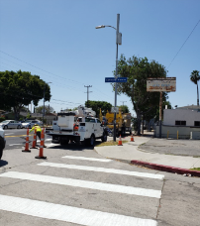
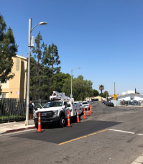
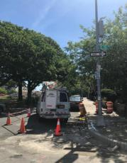
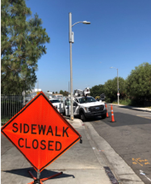
Vehicle Placement
Place the work vehicle between the work zone and oncoming traffic for protection. Make sure that wherever you position your vehicle, you have enough room to remove equipment and set it temporarily aside. Ensure that your vehicle is properly coned.
natehome.com
Notes:
Park work vehicles, equipment, and trailers to maximize safety. Vehicles should be parked upstream while trailers should be parked downstream of the worksite.

Slide 80
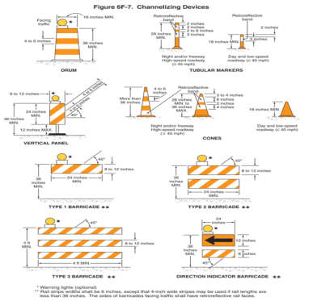
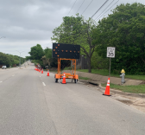
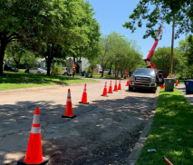
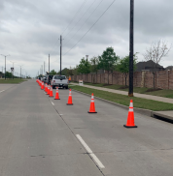
Channelizing Devices
Channelizing devices such as traffic cones, drums, and barricades.
natehome.com
Notes:
Diagram on the left outlines multiple examples of channelizing devices with standard measurements.
*All required channelizing devices will be shown in the approved TCP and must be followed exactly as shown.
**Devices can include traffic management elements including arrow boards, message boards, and even flaggers.

Slide 81
Section 6
Review Questions

Slide 82
Which of the following is a key component of the TCP?
Concrete blocks
Antennas
Channelizing devices
Power poles
natehome.com
Notes:
Answer: C (Channelizing Devices)

Slide 83
What is the name of the area where the work vehicle is deployed?
Right-of-Way
Work area/space
Termination area
Advance warning area
natehome.com
Notes:
Answer: B (Work Area/Space)

Slide 84
Section 7
Trenching and Excavation

Slide 85
Injuries and Fatalities
Trenching and excavation activities can cause:
Cave-ins
Suffocation
Crushing
Causing loss of circulation
Struck by falling objects
Underground utility strikes
Vehicular accidents
natehome.com

Slide 86
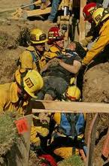
Injuries and Fatalities – Excavation
Excavating is one of the most hazardous construction operations.
Most accidents occur in trenches 5-15 feet deep.
There is usually no warning before a cave-in.
natehome.com

Slide 87
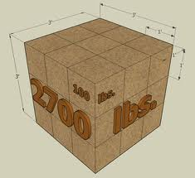
Injuries and Fatalities – Soil Weight
Pure dry sand
  90 pounds per cubic foot
  2,400 pounds per cubic yard
Saturated clay
  140 pounds per cubic foot
  3,700 pounds per cubic yard
natehome.com

Slide 88

Injuries and Fatalities - Trenches
Trench cave-ins are:
Predictable
Preventable
NOT accidents
natehome.com

Slide 89

Utility Avoidance and Protection Plan
Call 811 or equivalent One Call system and open a ticket.
Review construction drawings to identify known underground utilities.
Proposed trench path or excavation is to be marked on site.
Field verify that the proposed trench path or excavation has been marked on site along with all known utilities.
natehome.com
Notes:
Step 1: Call 811 or equivalent One Call system number to locate and mark primary utility systems. Items that are not located by the local Once Call system are to have those utility owners contacted directly. Third party locate companies are to be contracted to perform locate and marking services on private property where the state provided service does not enter.
Step 2: Site construction drawings are to be reviewed on-site with the property owner/landlord to identify/verify known primary (gas, water, communication, electric, sewer systems) and secondary (low voltage electrical systems, alarm systems, irrigation systems, etc.) underground utilities prior to contacting the utility locate service.
Step 3: The proposed location of the trench or excavation is to be marked out on the site/property using white turf paint or white flagging. Secondary utilities identified/verified by the property owner/landlord shall be marked using turf paint or flagging in accordance to the One Call Color Code requirements. Turf markings/flagging shall be documented by photograph and shall be attached to the utility avoidance plan.
Step 4: Crew supervisors are to field verify that primary and secondary utilities have been identified on-site through the use of turf markings or flagging and are in accordance with site construction plans.
Step 5: Utility safe tolerance zones are to be marked out on the site/property by the crew supervisor using turf marking paint or flagging. The width of the utility safe zone should be in accordance with state code or utility owner requirement. A safe zone, including the width of the utility plus 18 inches measured horizontally from each side of the utility, is to be used if a state code or utility owner requirement does not exist.

Slide 90

Utility Avoidance and Protection Plan (continued)
Use non-conductive tools/hydro-vac to pothole within the utility safe tolerance zone to verify and locate underground utilities.
Once the underground utilities have been identified and verified mechanical excavating or directional boring may commence.
natehome.com

Slide 91

Competent Person
Must have had specific training in and be knowledgeable about:
Soil classification.
The use of protective systems.
The requirements of applicable regulations.
Must be capable of identifying existing and/or predictable hazards and has the authority to correct them.
natehome.com

Slide 92
Inspection of Excavations
If the competent person finds evidence of a possible cave-in, indications of failure of protective systems, hazardous atmospheres, or other hazardous condition:
Exposed employees must be removed from the hazardous area.
Employees may not return until the necessary precautions have been taken.
natehome.com

Slide 93

Visual Test
The competent person should check for:
Cracks parallel to the edge of the trench;
Signs of existing utilities that indicate the soil has been previously disturbed;
Layered soils;
Signs of soil bulging or sloughing; and/or
The presence of water.
natehome.com

Slide 94




Manual Test
The competent person should perform a manual test to assist in identifying soil type using but not limited to the following soil testing equipment:
Pocket Penetrometer
Torvane Shear
Thumb Test
Soil Ribbon
natehome.com

Slide 95


Protection of Employees
Employees should be protected from cave-ins by using an adequately designed protective system.
Protective systems must be able to resist all expected loads to the system.
natehome.com
Notes:
Reference 1926.652(a)
Protective system – a method of protecting employees from cave-ins, from material that could fall or roll from an excavation face or into an excavation, or from the collapse of adjacent structures. Protective systems include support systems, sloping and benching systems, shield systems, and other systems that provide the necessary protection.
Several factors come into play when developing a total “protective system.” The design of of the system itself, how materials and equipment are handled in and around the excavation, and installation and removal of protective system components.
Reference 1926.652, 1926.652(b), 1926.652(c)
Benching -- excavating the sides of an excavation to form one or a series of horizontal levels or steps, usually with vertical or near-vertical surfaces between levels.
Shoring or shielding is used when the location or depth of the cut makes sloping back to the maximum allowable slope impractical. There are two basic types of shoring, timber and aluminum hydraulic.
Trench boxes (shielding) are different from shoring because instead of supporting the trench face, they are mostly serve to protect workers from cave-ins. The excavated area between the outside of the trench box and the face of the trench should be as small as possible. The space between the trench box and the excavation side may be backfilled (or other means may be used) to prevent lateral movement of the box. Shields may not be subjected to loads exceeding those which the system was designed to withstand. Trench boxes may be used in combination with sloping and benching.
Reference 1926.652(a)
Each employee in an excavation shall be protected from cave-ins by an adequate protective system except when:
Excavations are made entirely in stable rock; or
Excavations are less than 5 feet in depth and examination of the ground by a competent person provides no indication of a potential cave-in.
Protective systems shall have the capacity to resist without failure all loads that are intended or could reasonably be expected to be applied or transmitted to the system.

Slide 96

Trenching and Excavation Hazards
Protection from vehicles
Install barricades;
Hand or mechanical signals;
Grade soil away from trenches; and
Fence or barricade trenches left overnight.
natehome.com
Notes:
Reference 1926.651(f) Warning system for mobile equipment
When mobile equipment is operated adjacent to an excavation, or when such equipment is required to approach the edge of an excavation, and the operator does not have a clear and direct view of the edge of the excavation, a warning system shall be utilized such as barricades, hand or mechanical signals, or stop logs. If possible, the grade should be away from the excavation.

Slide 97

Trenching and Excavation Hazards (continued)
Access and egress hazards
Knee sprain
Ankle sprain
Lower back sprain
natehome.com

Slide 98
Section 7
Discussion

Slide 99

What is wrong in this picture?
If you were the competent person on this site how many deficiencies can you identify?
natehome.com
Notes:
This is designed to be interactive and generate a group discussion:
The deficiencies:
Employee in a trench that is 5’ or greater without any safety precautions (shoring, benching, etc.).
Spoil piles are not the required 2’ distance from the lip of the trench. The height of the spoil pile contributes to the overall height of the trench. This 5’ trench is now 10’ due to the spoil pile.
No safe access and egress.
The gentlemen in the background just came out of a manhole/confined space.
The cone you see in the back is covering the hole to the manhole. This is not a proper fall protection cover.
I’m sure there is more….but these are just a few

Slide 100
Section 8
Small Cell Electrical Hazard Identification

Slide 101
Disclaimer
This awareness training does not qualify you to handle electrical power lines and power company equipment. You must be an electrically qualified person to work on electrical lines and equipment.
natehome.com

Slide 102
Potential Electrical Hazards
Potential electrical hazards can be created by electrical lines which may come in contact with the telecommunications plant or that do not maintain sufficient clearance to allow employees to work safely.
In addition, special circumstances such as storm-related restoration work, accidental impact of a motor vehicle with a pole, overgrowth of vegetation, equipment failure, or improperly configured installations can increase the risk from energized telecommunications equipment.
natehome.com

Slide 103
Hazards of Electrical Power Line Proximity and Contact
Electrical energy can travel though any conductive material including the human body.
Hazards of contact with energized electrical lines and equipment:
  Shock
  Burns
  Falls
natehome.com
Notes:
Burns are the most common form of electrical shock related injury.
Falls occur when working at height and the worker makes electrical contact and falls backward off of the surface/ladder.

Slide 104

How Electricity Can Harm You
  Effects on your body
  Nervous system effects
  Damage to the heart and other organs
Falls
natehome.com
Notes:
Heart fibrillation can occur at 75 to 100 mA at 60 Hz. What is ventricular fibrillation? The heart beats when electrical signals move through it. Ventricular fibrillation (ven-TRIK'u-ler fib"rih-LA'shun) ("V fib") is a condition in which the heart's electrical activity becomes disordered. When this happens, the heart's lower (pumping) chambers contract in a rapid, unsynchronized way. (The ventricles "flutter" rather than beat). The heart pumps little or no blood. Ventricular fibrillation is very serious. Collapse and sudden cardiac death will follow in minutes unless medical help is provided immediately. If treated in time, V fib and ventricular tachycardia (ven-TRIK'u-ler tak"eh-KAR'de-ah) (extremely rapid heartbeat) can be converted into normal rhythm. This requires shocking the heart with a device called a defibrillator (de-FIB'rih-la-tor).
Electrical contact can damage nervous systems. The nervous system sends electrical impulses through the body. Interruption to those impulses could result in involuntary muscle movements resulting in falls or other bodily injuries. The damage to the nervous system could be permanent.

Slide 105
Dalziel's Table
Body Effect | Gender | 60 HZ AC
Slight sensation at point(s) of contact | Men | .0004 Amps
 | Women | .0003 Amps
Pain with voluntary muscle control maintained | Men | .009 Amps
 | Women | .006 Amps
Pain with loss of voluntary muscle control | Men | .016 Amps
 | Women | .0105 Amps
Severe pain and breathing difficulty | Men | .023 Amps
 | Women | .015 Amps
Possible heart fibrillation after 3 seconds | Men | 1/10 Amps
 | Women | 1/10 Amps
natehome.com
Notes:
Charles Dalziel's experimentation conducted at the University of California (Berkeley) began with a state grant to investigate the bodily effects of sub-lethal electric current. His testing method was as follows: healthy male and female volunteer subjects were asked to hold a copper wire in one hand and place their other hand on a round, brass plate. A voltage was then applied between the wire and the plate, causing electrons to flow through the subject's arms and chest. The current was stopped, then resumed at a higher level. The goal here was to see how much current the subject could tolerate and still keep their hand pressed against the brass plate. When this threshold was reached, laboratory assistants forcefully held the subject's hand in contact with the plate and the current was again increased. The subject was asked to release the wire they were holding, to see at what current level involuntary muscle contraction (tetanus) prevented them from doing so. For each subject the experiment was conducted using DC and also AC at various frequencies. Over two dozen human volunteers were tested, and later studies on heart fibrillation were conducted using animal subjects.

Slide 106

480V Arc Flash
Arc-blasts occur from high-amperage currents arcing through air.
Indirect contact with power can also result in a serious injury or death. An electrical arc can jump or “flash” between an energized object and a ground in the vicinity of an individual causing a severe flash burn to the exposed skin and clothing. The corresponding arc may also cause a flow of current through the tissue, resulting in the same type of injury as described previously.
natehome.com
Notes:
480 volt arc blast. Arc-Blast. Arc-blasts occur from high-amperage currents arcing through air. This abnormal current flow (arc-blast) is initiated by contact between two energized points. This contact can be caused by persons who have an accident while working on energized components, or by equipment failure due to fatigue or abuse. Temperatures as high as 35,000ºF have been recorded in arc-blast research. The three primary hazards associated with an arc-blast are: Thermal Radiation. In most cases, the radiated thermal energy is only part of the total energy available from the arc. Numerous factors, including skin color, area of skin exposed, type of clothing have an effect on degree of injury. Proper clothing, work distances, and over current protection can improve the chances of curable burns. Pressure Wave. A high-energy arcing fault can produce a considerable pressure wave. Research has shown that a person 2 feet away from a 25,000 amp arc would experience a force of approximately 480 pounds on the front of their body. In addition, such a pressure wave can cause serious ear damage and memory loss due to mild concussions. In some instances, the pressure wave may propel the victim away from the arc-blast, reducing the exposure to the thermal energy. However, such rapid movement could also cause serious physical injury. Projectiles. The pressure wave can propel relatively large objects over a considerable distance. In some cases, the pressure wave has sufficient force to snap the heads of 3/8-inch steel bolts and knock over ordinary construction walls. The high-energy arc also causes many of the copper and aluminum components in the electrical equipment to become molten. These "droplets" of molten metal can be propelled great distances by the pressure wave. Although these droplets cool rapidly, they can still be above temperatures capable of causing serious burns or igniting ordinary clothing at distances of 10 feet or more. In many cases, the burning effect is much worse than the injury from shrapnel effects of the droplets.

Slide 107
Electrical Potential
Electricity flows when two objects with different electrical potentials touch. Just like water running downhill, electricity flows from a high potential, which is voltage pressure, to a low potential, which is ground. A current flows between the two points, from high potential to low potential. If you are caught between these two objects, an electric shock will result.
natehome.com

Slide 108

Step and Touch Potential
The potential difference between two points on the earths surface, separated by the distance of one pace (3 feet) in the direction of the maximum potential.
Potential difference between a grounded metallic structure/object and a point on the earths surface equal to the normal maximum horizontal reach of a person (approximately 3 feet).
natehome.com
Notes:
Step potential is caused by a flow of fault current through the earth. In a fault current condition a current flow causes a voltage drop at the earth’s surface. This happens because voltage and current are inversely proportional. When current rises, voltage drops and vice versa. Grounds will direct fault currents to the earth. This fault current will radiate outward in circles from the ground connection point or structure. A person standing close to the structure with their feet apart, bridges a part of this current. This places a potential difference between the persons feet. The methods presently in use to protect a worker in this area is either isolating (non conductive mat), or a grounding (conducting) mat. An isolating mat will protect the employee by insulating him or her from the earth. A grounding mat, connected to the structure keeps the employee at the same potential as the structure. In either case, the worker must stay on the mat to be protected. One alternative to mats are rubber overshoes. A problem with over shoes is the radiant step current may exceed the di-electric rating of the shoe. This could be a problem to persons working on transmission systems where the fault currents are very high.
Touch potential is a problem similar to step potential. It involves a fault current flow in the earth setting up a potential difference between the earth/ground contact point and some remote hardware. An example would be a worker touching a transmission tower leg while standing on the earth. Protection for touch potential is the same as step potential. Approved insulating gloves can also be used to offer some protection when workers are required to come in contact with poles, towers, equipment or vehicles having a touch potential hazard.
This is why using a voltage tester is so important. It lets you safely check the electrical potential on all foreign objects near your work area.

Slide 109




Aerial Equipment
Aerial equipment
  Path to ground
natehome.com
Notes:
Explain that aerial lift trucks represent a possible path to ground. Workers touching the truck can be injured or killed. Additionally, boom equipped trucks designed with controls mounted on the truck chassis and those equipped with pendant controls place the operator in direct contact with the ground. If an unintentional power line contact occurs, the operator is likely to sustain an electrocution injury. Some manufacturers offer boom truck designs which place the operator on an elevated platform, isolated from the ground. Others incorporate pendant controls activated by radio frequency or fiber-optics. It is important to note that even when cranes are equipped with radio or fiber-optic controls, an operator can still sustain injury as current can flow through the ground, creating a hazard. If the boom is in an energized zone, do not touch the truck. Remember, the insulating bucket will not protect the operator from hand-to-hand contact with different potentials. Aerial lift trucks with insulated booms must be electrically tested on an annual basis. This helps ensure the insulating sections of the boom are in good condition.
Ask this question: How could a worker on the ground be affected by a bucket truck contacting an overhead line? Electrocution through touch potential.

Slide 110
Bonding
Bonding is electrically connecting two or more pieces of communication hardware, or connecting communication hardware to hardware belonging to another utility to maintain a common electrical potential. Bonding conductors must be of sufficient gauge to carry anticipated current in the event of a power contact.
natehome.com

Slide 111

Grounding
Electrically connecting communication hardware to an effective electrical ground.
natehome.com
Notes:
Grounding is electrically connecting communication hardware to an effective electrical ground. An effective electrical ground can be a power system MGN, (Multi grounded Neutral) a grounded neutral of a secondary power system with at least three customer services connected, a metallic water system, an extensive underground or buried cable system, or a specially constructed grounding network.
An effective electrical ground is a low-impedance ground, such as the power MGN, that is low enough to operate protective equipment. Electrical connection to a low-resistance ground permits electric current to discharge to ground without the buildup of hazardous voltages on the communication plant in case of electrical contact.

Slide 112

Joint-Use Poles
POLE EXTENSION
Non-conductive structure used to elevate the antenna above the primary lines to achieve minimum separation requirements.
PRIMARY INSULATOR
Used to insulate (separate) the high voltage wire from the structure, cross arm, or pole.
FUSE
Protective device used to insulate (separate) the equipment from the high voltage wires and protect from large power surges.
TRANSFORMER
Used to step down primary voltage power to secondary voltage power (120/240v or 120/208v).
COMMUNICATION LINES
Cable TV, Telecom Fiber, Phone Lines, used to transmit voice and data from the customer to the service provider’s network.
GROUND MOULDING
Non-conductive product used to cover the ground wire along the length of the pole usually strapped or stapled to pole structure.
RISERS / U GUARD
Used to insulate (primary / secondary) cables from pedestrians and the structure.
AC METER AND DISCONNECT
Device used to measure power consumption of the customer and to provide for emergency shut off. Required by NEC to be 4-6 AGL.
natehome.com
Notes:
The NESC governs the placement of lines and equipment on utility poles. Although the NESC makes a determination where utilities may place their equipment, it jurisdiction may have different rules. The NESC should be used as a reference and not a hard and fast rule. None qualified communications workers must stay a minimum of 10 feet from energized lines and equipment up to 50kV. An additional 4” per 10,000V is added for voltages over 50,000V (29 CFR 1910.333(c)(3)(i)).

Slide 113
Minimum Approach Distances (MAD)
Higher voltages can arc over several inches or even feet under some conditions, so greater distances need to be maintained when working in the vicinity of primary conductors.
MAD can be found in 1910.268 Table R2.
Voltage Range (phase to phase, RMS) | Approach distance (inches)
300 V and less | Avoid Contact
Over 300V, not over 750V | 12
Over 750V not over 2 kV | 18
Over 2 kV, not over 15 kV | 24
Over 15 kV, not over 37 kV | 36
Over 37 kV, not over 87.5 kV | 42
Over 87.5 kV, not over 121 kV | 48
Over 121 kV, not over 140 kV | 54
Note: An approach distance is the distance which you can approach the energized conductor with either your body or any object which you are in contact with. Secondary conductors which are used to supply power to a residence are below the 300v phase to phase voltage. For this reason DO NOT come in contact with secondary voltage lines. Primary voltage which is normally above 300v phase to phase requires a minimum distance to approach. If primary voltage is present in your workspace, do not proceed and notify your supervisor immediately.
natehome.com
Notes:
In order for a worker to utilize the R2 table they need to know 3 things:
The voltage present
The minimum approach distance for the voltage
What parts/lines have the potential to be energized
Some state plan’s have more stringent MAD clearances then the 1910.268 R2 table. Employers/workers should be familiar with and reference them if working in a state OSH jurisdiction.

Slide 114
Be Aware of Hazards on Adjacent Poles
Check these poles for any potential electrical hazards that may affect the workspace that you are working in.
Electrical hazards can travel along conductors such as strand, guy wires, cable or any conductor which travels to your workspace.
A potential hazard at an adjacent pole can also be a potential hazard at your workspace.
natehome.com

Slide 115



Voltage Detectors
natehome.com
Notes:
A Foreign voltage detector is used to detect the presence of an electric field. Communications workers should test conductive surfaces in their work areas prior to conducting job tasks. The detectors should be checked on a known energized source prior to and after use.
Test:
Ground wire
Underground power conduit
Any other potential electrical hazard, e.g. poles
Un-insulated vertical grounds, electrical power guards, and conduits
Street light fixtures and pole hardware
Metal terminals and cabinets
Grounds and bonds
Metal fences

Slide 116

AC Testing
natehome.com
Notes:
40” Umbrella of safety – test everything within 40” of the potential work area.
*Remember to not violate the MAD clearance chart previously discussed.

Slide 117
Additional Considerations
Depending on the scope of work, you may be required by regulation to utilize additional protective equipment including but not limited to:
  Rubber insulated gloves/blankets
  Fire Retardant (FR) clothing
  Insulated tools
natehome.com
Notes:
Follow your company's requirements for testing and use of rubber insulating gloves/blankets.

Slide 118


Isolating Energy Sources
Lockout/Tagout (LOTO) Program
  LOTO procedures remove hazardous sources of electricity from circuit parts that will be worked on by employees.
Employer Responsibilities
  Provide equipment necessary to LOTO program.
  Provide training on LOTO procedures.
  Regularly audit LOTO program.
natehome.com
Notes:
There are several potential energy sources on utility poles – Electric & RF are 2 of them. Employers need to establish an effective LOTO program. Workers should follow their employer’s program and shut down and lock out potential energy sources prior to working on them.

Slide 119


Lockout/Tagout Principles
Control of Energy: All energy sources must be controlled so that employee exposure to electrical hazards is minimized.
Electrical Circuit Interlocks: Drawings or diagrams must be reviewed to ensure interlock devices are present which might re-energize the circuit.
natehome.com
Notes:
Energy sources can also be RF.

Slide 120


Forms of Control of Hazardous Electrical Energy
Simple Lockout/Tagout
Complex Lockout/Tagout
natehome.com
Notes:
Simple Lockout/Tagout – Involves only one department, group, craft, or employer, and does not involve a shift change. Contains no potential to release a hazardous material.
Complex Lockout/Tagout - involves but not limited to more than one craft, more than one energy source and/or more than one disconnecting means.

Slide 121
Section 8
Review Questions

Slide 122
When does electrical current flow between two objects?
One object has high electrical potential and the other has low electrical potential.
Both objects have high electrical potential.
Both objects have low electrical potential.
Both objects have identical electrical potential.
natehome.com
Notes:
Answer: A (One object has high electrical potential and the other has low electrical potential)

Slide 123
What hazard is present when a person touches an object with a difference in electrical potential?
Electrical potential
GFCI
Electric shock
Nothing
natehome.com
Notes:
Answer: C (Electric shock)

Slide 124
Section 9
Fiber Optic Safety Basics
Notes:
Fiber services as the backbone for most small cell sites. Without fiber, our wireless infrastructure wouldn’t communicate to the head-end. Each small cell site requires the use of several strands of fiber. Fiber optics, in simple terms uses light impulses to transmit data near the speed of light.
Fiber is a glass tube smaller than a human hair. Cladding wrapped around the fiber causes the light impulse to travel through the glass tube. Individual fibers are bundled together into buffer tubes, each containing about 12 fibers. Fiber strands are spliced together to increase length or send signals along another fiber cable. At the head end and at the small cell, the cables are tipped for insertion into the equipment.

Slide 125
Fiber Optic Safety
When working with fiber optics or lasers:
  Wear safety glasses or goggles when handling fibers or chemicals.
  Work on a dark surface if splicing fiber.
  No eating, drinking, or smoking while splicing fiber.
  Always wash you hands after splicing fiber.
  Do not touch your eyes until after you have washed your hands.
  Pick up cleaved fiber ends with a piece of adhesive tape. Count them to be sure you find all of them and dispose of them. They are sharp, hard to find, and easily penetrate the skin.
natehome.com
Notes:
Working on a dark surface allows the worker to better see loose or broken fiber strands.
Eating, drinking and smoking while splicing fiber opens up the worker to potential loose glass being ingested. Broken fiber is easy to lose track of and can stick to the worker. When they bring their hands to their face to eat/drink/smoke the shards and splinters can get into the food or directly into the mouth and swallowed. Once inside they can cause bleeding.
Likewise, do not touch our eyes or remove or insert contact lenses until after thoroughly washing hands after working with fiber. Shards of glass could end up in your eyes.
Good Housekeeping is always a safety best practice. With fiber things to remember include having a scrap fiber container and having a place to discard the cable components. Some fiber technicians utilize a couple rolls of tape rolled backward (sticky side out) to stick the cut fiber to. Cleaning up well decreases the likelihood of fiber going home with you on clothing or ingesting it.

Slide 126

Fiber Optic Safety (continued)
Never smoke or have open flames near splicing areas.
Use a Fiber Inspection Probe Kit or other approved device to view fiber connectors.
Never use optical magnification or stare directly into an open or broken unterminated fiber.
Power down and lock out network laser sources before servicing equipment within enclosures.
natehome.com

Slide 127

More Fiber Optic Safety Tips
Only work on unenclosed powered laser sources if you are trained and authorized to do so.
A disposable apron can prevent you from taking broken glass home.
Never look into the end of a fiber strand or cable. Unless you are positive no light source is connected.
Clean up well!
natehome.com
Notes:
A disposable apron is a useful tool to use when working with fiber. If broken fibers ends up on a workers clothing they could take it with them and it could end up in food or other locations.
As discussed earlier, the signals in a fiber cable are transmitted via light. The light is not typically visible and the wavelengths it travels at can damage the eyes. Never look into the end of a fiber cable without testing it to ensure no signals are being transmitted.

Slide 128

Tools and PPE
Use the right tools for the job
  Stripping tool – no utility knives
Required PPE
  Wear nitrile gloves when using cleaning agents, solvents or other chemicals. Be sure to follow the chemical manufacturer’s instructions.
  Appropriate safety glasses.
  Other work gloves.
natehome.com
Notes:
Using the correct tool for the job is always a best practice. Stripping tools are designed to cut to the proper depth for stripping the cable and also protect the worker from exposure to an open blade. Utility knives are effective at stripping cable but require the skills to cut to the proper depth and expose the worker to the cutting blade.
Safety glasses need to be worn because of the potential for loose glass and other parts of the fiber cable that could strike the worker in the eyes. Depending on the work being completed, safety glasses for use around lasers may be appropriate. The glasses should be rated for the wavelengths anticipated. Discuss the need for this type of safety glass with your company management. Gloves should be worn for as long as possible to protect the hands from cuts and punctures.

Slide 129
Section 9
Review Questions

Slide 130
What activity or activities should you NOT do while splicing fiber?
Eat
Drink
Smoke
All of the above
natehome.com
Notes:
Answer: D (All of the above)

Slide 131
How should you secure loose fiber?
You could place it into a designated container.
Leave it alone on the table.
Tape could be used to stick the cut strands to.
Both A & C.
natehome.com
Notes:
Answer: D (Both A & C)

Slide 132
Section 10
Working at Height
Bucket Truck/Mobile Elevated Work Platform (MEWP)
Dropped Objects
Ladders

Slide 133
Bucket Truck/Mobile Elevated Work Platform (MEWP)

Slide 134



Types of MEWP
natehome.com
Notes:
Mobile Elevated Working Platforms (MEWPS) can fall into the following categories:
Telescopic Boom Lift
Knuckle Boom Lift
Bucket Truck
Telescopic
This design of a Telescopic MEWP usually has a straight, rigid boom that cannot bend at any point between the base and the platform.
The boom section of a Telescopic is the link between the turret and the platform and can be utilized to position the platform at various distances and heights from the base.
You can activate the boom using either the ground or platform controls to raise, lower, extend or retract it.
There are two main types of boom designs, each with different and distinct operating characteristics, as well as inherent design advantages and disadvantages.
Also known as a "straight," "rigid," or "stick" boom, a telescopic boom is comprised of two, three or four sections made of aluminum, steel, or a combination of both.
Moving the boom sections is accomplished by activating hydraulic cylinders connected directly to the boom sections or by activating a hydraulic cylinder that operates cables or chains that connect to the boom sections.
The individual boom sections fit within a primary boom section. When activated, these sections will extend progressively outward, increasing the overall boom length, or retract and collapse within each other, decreasing the overall boom length.
Knuckle Booms
Bucket trucks may be used for lifting personnel and/or lifting equipment and materials.
These units are designed to work in tighter, more congested areas.
They are also capable of placing the platform at locations that would be difficult, if not impossible, for a telescopic unit.
Otherwise known as a "knuckle" boom, an articulated boom is comprised of several sections made of steel, aluminum or both, connected by flexible joints or knuckles between each section.
When activated, these sections will unfold from one another to extend and increase the overall boom length and/or height, or fold over top of each other in an accordion-like fashion to retract and decrease the overall length and/or height.
The section of the boom that is connected to the platform is usually capable of telescoping in and out
Articulated booms, commonly called knuckle booms, have a flexible joint(s) located at various points between the base and the platform.
This allows the boom to bend and articulate, as directed by the operator. The boom section that connects to the platform can also telescope in and out.
These units are designed to work in tighter, more congested areas.
They are also capable of placing the platform at locations that would be difficult, if not impossible, for a telescopic unit.
Bucket Truck
Bucket Trucks are designed to either lift personnel or equipment and materials.

Slide 135

Bucket Truck – Potential Hazards
The following is a list of potential hazards associated with working aloft in an aerial basket:
  Faulty equipment.
  Falling from the bucket.
  Contact with electrical power.
  Exposure to traffic.
  Unintentional movement of the vehicle.
natehome.com

Slide 136

Bucket Truck – Aerial Lift
Aerial lift operators must be trained on the specific type of lift they are to operate.
Operators of aerial lifts must become familiar with the manufacturer’s specific recommendations for safe entry and exit procedures from the basket.
Keep the basket access area free of loose items that may pose a trip hazard.
natehome.com

Slide 137

Bucket Truck - Inspections
Before flying the basket, operators must perform manufacturer recommended pre-use inspections.
Before entering the aerial lift ensure all required PPE is available.
Extra caution should also be used when wet or icy conditions are present.
natehome.com

Slide 138
Basket Steps
Once you have safely entered the basket the following steps are required:
Immediately attach the full-body harness safety lanyard to the boom anchor.
If equipped, close the basket door and visually ensure the latch and/or chain are secured before going aloft.
Always stand with both feet on the floor. Never sit or stand on the edge of the basket to reach your work. If necessary reposition the basket.
natehome.com

Slide 139
Basket Steps (continued)
The aerial lift Interlock Safety Switch is provided to avoid accidental movement of the boom.
This safety switch must be used in connection with the other bucket controls to maneuver the bucket.
These safety controls MUST NOT BE BYPASSED or OVERRIDDEN for any reason.
natehome.com

Slide 140

Electrical Safety
Be sure to conduct a thorough pre-job survey for all hazards including any possible electrical hazards.
Maintain a safe approach distance for the voltages to be encountered. Test all items in your work space with a voltage detector before making contact.
Be sure to follow all safety precautions related to working in the vicinity of power (approach distance, clearance and separations, bonding and grounding procedures, etc.).
natehome.com

Slide 141
Work Area Protection
Ensure placement of appropriate traffic cones, flags, warning signs, etc. (per State/DOT Requirements).
Be sure to protect the entire work area, especially where the boom may extend into vehicular traffic.
Pedestrian traffic must be managed.
natehome.com

Slide 142
Other Safety Tips
Ensure the aerial device controls are labeled correctly and clearly.
Never overload the maximum basket weight capacity (your body weight, tools, hardware, and material).
If the vehicle is equipped with outriggers, they must be used during stationary work operations.
To prevent vehicle tip over when extending the basket to the side, the "maximum" safe working slope is 5 degrees.
natehome.com

Slide 143

Unit Setup
If operating in the vicinity of an overhead crane, take steps to ensure that there is no possibility of collision between it and your unit.
Take a moment to observe wind and weather conditions and decide if it is appropriate to continue.
Determine the hazard potential posed by any flammable, explosive and/or toxic materials that may be in the area and/or atmosphere. Avoid operating in hazardous locations/atmospheres.
natehome.com
Notes:
When you arrive at the work location you will need to complete a few safety items, which are:
Perform a site inspection, giving particular attention to the ground conditions and the presence of overhead power lines in the area where you intend to set-up the unit.
Check for clearances and conditions around buildings, structures and/or objects.
Remember, you should maintain a clearance of at least two feet (60 cm) between the unit and all fixed objects in order to avoid creating crush zones.
Avoid slopes and grades, and make sure that the intended setup area is level or within the manufacturer's specifications.
If there is moderate vehicular and/or pedestrian traffic in the area, you should consider using barricades, traffic cones, signs, and/or a spotter to keep the traffic out of the unit's operating area.
If operating in the vicinity of an overhead crane, take steps to ensure that there is no possibility of collision between it and your unit.
Take a moment to observe wind and weather conditions and decide if it is appropriate to continue.
Determine the hazard potential posed by any flammable, explosive and/or toxic materials that may be in the area and/or atmosphere. Avoid operating in hazardous locations/atmospheres.

Slide 144

Slope Warning System
A system that activates an audible and/or visual alarm whenever the base goes off level by more than five degrees or a lesser amount specified by the manufacturer.
natehome.com
Notes:
A system that activates an audible and/or visual alarm whenever the base goes off level by more than five degrees or a lesser amount specified by the manufacturer.

Slide 145

Unit Setup - Wheel Chocks for Bucket Trucks
Place the vehicle automatic transmission in ”park,” (or in gear if it is a manual transmission), then properly engage the parking brakes and place a minimum of two (2) chocks.
natehome.com

Slide 146



Unit Setup – Wheel Chocks for Bucket Trucks
natehome.com
Notes:
Level Grade
Turn front wheels to curb or field side
Place two chocks:
Chock front of load side rear wheel
Chock back of load side rear wheel
Downhill
Turn front wheels to curb or field side
Place two chocks:
Chock downhill side of front wheel load side
Chock downhill side of rear wheel load side
Uphill
Turn front wheels to curb or field side
Place two chocks:
Chock downhill side of front wheel load side
Chock downhill side of rear wheel load side

Slide 147
Dropped Objects

Slide 148

Dropped Objects
Objects at height pose a hazard to workers and by-standers on the ground.
In 2016, the Bureau of Labor Statistics reports there were 255 fatalities and 47,920 reported injuries from dropped objects in the United States, making this the third leading cause of injuries on the jobsite, according to OSHA.
natehome.com
Notes:
ANSI/ISEA 121-2018 developed for the manufacture of equipment for dropped object prevent.
OSHA requires that employers protect their workers from falling objects. Traditionally this is done with a hardhat. By using only a hardhat, the object is still permitted to fall and could still strike a worker on a lower level or the ground where the hardhat doesn’t offer protection. By utilizing ANSI 121 compliant equipment to secure objects, the drop hazard is all but eliminate.

Slide 149

Dropped Objects (continued)
Objects generally don’t fall straight down.
An object in free fall experiences an acceleration of -9.8 m/s2.
A 10 pound tool dropped from 10 feet would have a striking force of 106 lbs. travelling at 35 mph.
natehome.com
Notes:
ANSI/ISEA 121-2018 developed for the manufacture of equipment for dropped object prevent.
OSHA requires that employers protect their workers from falling objects. Traditionally this is done with a hardhat. By using only a hardhat, the object is still permitted to fall and could still strike a worker on a lower level or the ground where the hardhat doesn’t offer protection. By utilizing ANSI 121 compliant equipment to secure objects, the drop hazard is all but eliminate.

Slide 150

Dropped Object Prevention System
Here are some examples of different components of a dropped object prevention system.
natehome.com

Slide 151
Ladders

Slide 152

Ladders
The load rating of the ladder must accommodate the total weight of the user plus the weight of what is carried.
If the load rating is insufficient, don’t use it! A type 1A fiberglass ladder or step stool with a load capacity of 300 pounds is recommended. Type 1AA has a load capacity recommendation of 375 pounds.
If there is a need for another type of ladder, contact your manager. Metal ladders must not be used if you are performing any electrical work or in the vicinity of energized lines or parts.
natehome.com

Slide 153

Ladder Inspection
    Inspect the ladders for:
      Cracks, splits, splinters, decay, protruding nails, and loose rivets.
      Loose, bent or broken braces, tie rods, guide irons, and pulleys.
      Broken, worn or defective spurs and pads, frayed or badly worn ropes.
    Ladders with defects should not be used and should be reported to your Supervisor immediately.
    Check the ladder for weight bearing rating before use.
    Inspect wooden ladders when dry because moisture absorption may cause swelling and conceal defects.
natehome.com

Slide 154

Stepladders
Set up the ladder on a firm, level base.
Open the ladder completely and lock both spreader braces.
Place tools and equipment on the ladder shelf before climbing, or use a tool belt.
Be sure the ladder is rated for its intended load.
Face the ladder and maintain three points of contact when climbing or descending.
Never lean beyond the side rails; reposition the ladder instead.
Never sit or stand on the top step or shelf of the ladder or the second step from the top.
natehome.com

Slide 155

Extension Ladders
Ensure the ladder is on solid ground and has level footing.
Use a 4:1 ratio (about a 75° angle) when placing extension ladders. Perform the “Firefighters’ Check” or use the NIOSH app to ensure positioning.
Secure the ladder when setting up on a pole.
Maintain three points of contact when ascending and descending.
While utilizing an extension ladder follow your company’s fall protection requirements.
natehome.com

Slide 156
Section 10
Review Questions

Slide 157
When inspecting extension ladders you should check for the following; side rails for chips, cracks, dents, fractures, gouges, splits, scratches, and scuffs.
True
False
natehome.com
Notes:
Answer: A (True)

Slide 158
Contact with ________ is one of the hazards associated with using an MEWP.
Electrical power
Trees
Motor vehicles
All of the above
natehome.com
Notes:
Answer: A (Electrical Power)

Slide 159
The third leading cause of injuries on the jobsite in the United States, according to OSHA is?
Dropped objects
Ice skating
Rock climbing
Dog walking
natehome.com
Notes:
Answer: A (Dropped Objects)

Slide 160
Who is directly responsible for ensuring that all platform occupants are wearing the required fall protection gear?
Employer
Operator
Engineer
Manufacturer
natehome.com
Notes:
Answer: B (Operator)

Slide 161
If you encounter a serious problem with your MEWP, or ladder during a pre-use inspection, you should?
Do not take it to a mechanic or repair person.
Operate it very slowly.
Tag it out and report the problem to a supervisor.
Fix the problem before operating the unit.
natehome.com
Notes:
Answer: C (Tag it out and report the problem to a supervisor)

Slide 162
Section 11
Radio Frequency Hazards

Slide 163

Is 5G Safe?
CTIA – 5G, Health and Safety Video
5G, Health and Safety
natehome.com
Notes:
Play CTIA 5G, Health and Safety Video (https://youtu.be/hlea0nLRd6o)

Slide 164

What do the Experts Say?
“The FCC regulates RF emissions, including millimeter waves from 5G devices and equipment, and has adopted the recommendations of expert scientific organizations that have reviewed the science, including dozens of studies focused specifically on millimeter waves, and established safe exposure levels. In December of 2019, the FCC reaffirmed – on a unanimous and bipartisan basis – these safety standards.”
natehome.com
Notes:
FCC - Source: CTIA Wireless Health Facts website (https://www.wirelesshealthfacts.com/experts/)

Slide 165

World Health Organization
“Recent surveys have indicated that RF exposures from base stations and wireless technologies in publicly accessible areas (including schools and hospitals) are normally thousands of times below international standards . . . From all evidence accumulated so far, no adverse short- or long-term health effects have been shown to occur from the RF signals produced by base stations.”
natehome.com
Notes:
World Health Organization - Source: CTIA Wireless Health Facts website (https://www.wirelesshealthfacts.com/experts/)

Slide 166

U.S. Food & Drug Administration
“Based on our ongoing evaluation of this issue, the totality of the available scientific evidence continues to not support adverse health effects in humans caused by exposures at or under the current radiofrequency energy exposure limits.”
natehome.com
Notes:
U.S. Food & Drug Administration - Source: CTIA Wireless Health Facts website (https://www.wirelesshealthfacts.com/experts/)

Slide 167

National Institutes of Health
“… although many studies have examined the potential health effects of non-ionizing radiation from radar, microwave ovens, cell phones, and other sources, there is currently no consistent evidence that non-ionizing radiation increases cancer risk in humans.”
natehome.com
Notes:
National Institutes of Health - Source: CTIA Wireless Health Facts website (https://www.wirelesshealthfacts.com/experts/)

Slide 168

American Cancer Society
“At ground level near typical cellular base stations, the amount of RF energy is thousands of times less than the limits for safe exposure set by the US Federal Communication Commission (FCC) and other regulatory authorities … Some people have expressed concern that living, working, or going to school near a cell phone tower might increase the risk of cancer or other health problems. At this time, there is very little evidence to support this idea.”
natehome.com
Notes:
U.S. Food & Drug Administration - Source: CTIA Wireless Health Facts website (https://www.wirelesshealthfacts.com/experts/)

Slide 169

New Orleans City Council
“Typical exposure to 5G devices—such as small cells attached to phone poles or the sides of buildings - is far below the permissible levels and comparable to Bluetooth devices and baby monitors.”
New Orleans City Council Meeting (December 2019)
natehome.com
Notes:
New Orleans City Council Hearing, 2019 - Source: CTIA Wireless Health Facts website (https://www.wirelesshealthfacts.com/experts/)

Slide 170

Physical Hazard
Because RF (Radio Frequency) energy is recognized as a physical hazard, you must consider both the worker’s and the public’s exposure when planning deployment and/or maintenance activity on a Small Cell Node or any location where RF energy may be present.
natehome.com
Notes:
Many people have expressed concerns over RF exposure due to the increased deployment of 5G nationwide. Small Cells, while not all 5G technology, are at a lower height and have increased visibility for the public.

Slide 171
Radiation Types
Ionizing
  Typical cultural reference for “radiation.”
  Can have many adverse long-lasting health consequences.
Non-Ionizing
  Spectrum below “visible light.”
  Normally associated with “signal” including radio waves and microwaves.
natehome.com
Notes:
Discuss what people think about when you say “Radiation.” Most believe “Radioactive” and “Radiation” go hand in hand.

Slide 172

What is Non-Ionizing Radiation?
Non-ionizing radiation is described as a series of energy waves composed of oscillating electric and magnetic fields traveling at the speed of light.
natehome.com

Slide 173
General Population/Uncontrolled
Exposure Level - Not Trained
Applies to situations in which the public may be exposed or persons who are exposed as a part of their employment (workers).
They may have not been made fully aware of the potential for exposure or cannot exercise control over their exposure.
natehome.com
Notes:
This includes workers. If the worker is not trained and provided with the ability to ensure they are not being overexposed.

Slide 174

Controlled Exposure
Controlled Environments: locations where there is exposure that may be incurred by persons who are made “fully aware” of the potential for exposure and can exercise control over their exposure.
natehome.com
Notes:
This includes workers. If the worker is not trained and provided with the ability to ensure they are not being overexposed.

Slide 175


Personal Protection Monitors
Personal monitors can be useful tools.
Care must be used in selecting a monitor that is appropriate for the range of potential frequencies of the exposure fields and which responds appropriately to the RF field.
In addition, training on appropriate use of personal monitors and their limitations (such as frequency response and detection angles) is important if monitors are to be used effectively.
natehome.com
Notes:
A best management practice (BMP) is that the RF Personal Protective Monitor (PPM) has precedence above all other things like signage and barriers as remember things change on telecom sites. It’s critical to read the instruction manual on how to properly use the PPM. They should be worn on the front of the body, not in your back pocket, as your body is shielding the RF from the monitor is in the back pocket. Please ensure you follow your company's procedure for use of RF monitors and to know what type of Monitor your company uses.
What are the appropriate ranges?

Slide 176



RF Site Signage
Shall use the ANSI symbols and colors.
Shall be used as an integral part of an overall site compliance plan.
Be aware of signage as this indicates RF is on the site.
natehome.com
Notes:
Requirements
https://www.osha.gov/pls/oshaweb/owadisp.show_document?p_table=FEDERAL_REGISTER&p_id=23993
Blue: Under 20% of the controlled standard (under the uncontrolled standard).
Yellow: Between 20-99% of the controlled standard (the area between the yellow and red lines as shown in the MPE chart).
Red: Above the controlled standard.

Slide 177
Section 11
Review Questions

Slide 178
What type of radiation is radio frequency?
Ionizing
Gamma ray
Non-ionizing
None of the above
natehome.com
Notes:
Answer: C (Non-Ionizing)

Slide 179
What type of ANSI signage is blue in color?
Notice
Caution
Warning
Beware of dog
natehome.com
Notes:
Answer: A (Notice)

Slide 180
Section 12
Confined Spaces

Slide 181
Confined Space
Large enough
to bodily enter
A space must have all three characteristics to meet the confined space definition.
Limited or restricted
access
Not designed for
continuous occupancy
Confined
Space
natehome.com
Notes:
Flowchart for confined space definition.

Slide 182



Permit-Required Confined Space
Has or has the potential to contain a hazardous atmosphere?
Oxygen deficient (19.5% or less)
Oxygen enriched (23.5% or more)
Flammable (10% Lower Explosive Limit (LEL) or more)
Toxic (above Permissible Exposure Limit (PEL))
Combustible dust (at or above LEL)
Other Immediately Dangerous to Life and Health (IDLH)
natehome.com
Notes:
Permit-required confined space definition flowchart step 1.
Atmospheric hazards have historically caused the majority of deaths in confined spaces.
It is critical to recognize that the definition includes not only spaces where there is a known hazardous atmosphere but also those that have the potential for a hazardous atmosphere.
LEL = Lower Explosive Limit
PEL = Permissible Exposure Limit
IDLH = Immediately Dangerous to Life and Health

Slide 183



Potential Engulfment
Has the potential for engulfment?
Engulfment may occur by materials being introduced or removed from the space or by an entrant being drawn down into materials.
natehome.com
Notes:
Permit-required confined space definition flowchart step 2.
Engulfment typically refers to hazards associated with granular materials. These are also called flowable solids. Examples include; grain, coal, sand, gravel, sawdust, and resin pellets.
An entrant may also be engulfed by liquids.

Slide 184


Internal Configuration Hazard
Internal configuration hazard?
Has an internal configuration such that an entrant could be trapped or asphyxiated by inwardly converging walls or by a floor which slopes downward and tapers to a smaller cross section.
natehome.com
Notes:
Permit-required confined space definition flowchart step 3.
OSHA’s definition is limiting and refers to a funnel bottom shape that is common in many types of hoppers.
The hazard assessment of the space should consider all types of configurations that increase the risk to the entrants.

Slide 185


Other Hazards
Any other
recognized serious
safety or health
hazard?
Other hazards capable of causing death, serious physical harm, or interfering with the entrants ability to escape.
natehome.com
Notes:
Permit-required confined space definition flowchart step 4.
This is a very broad statement that clearly puts the obligation on us to identify and consider all hazards associated with the space.

Slide 186
Examples of Confined Spaces
Tanks | Vaults
Manholes | Pipes
Boilers | Trenches
Furnaces | Tunnels
Sewers | Ducts
Silos | Bins
Hoppers | Pits
natehome.com

Slide 187
Hazards in Confined Spaces
Oxygen Deficiency
  <19.5% or >23.5% oxygen concentration
Combustibles
  Methane
  Hydrogen
  Acetylene
  Propane
  Gasoline fumes
Toxic Materials
  Carbon Monoxide
  Hydrogen Sulfide
  Welding fumes
  Corrosives
Electricity
Mechanical Hazards
  Mixers
  Crushers
natehome.com

Slide 188
Testing the Atmosphere
In this Order:
Check for Oxygen Content:
  At least 19.5% and less than 23.5%.
Check for Combustibles:
  Less than 10% of the LEL.
Check for Toxic Gasses:
  Most commonly carbon monoxide (PEL <35 ppm) and H2S.
  Most multi-gas monitors automatically test in this order.
natehome.com
Notes:
Before an employee enters the space, the internal atmosphere must be tested, with a calibrated direct-reading instrument, for the following conditions in the order given:
Oxygen content
Flammable gases and vapors.
Potential toxic air contaminants.
There may be no hazardous atmosphere within the space whenever any employee is inside the space.
Continuous forced air ventilation must be used, as follows:
An employee may not enter the space until the forced air ventilation has eliminated any hazardous atmosphere.
The forced air ventilation must be so directed as to ventilate the immediate areas where an employee is or will be present within the space and must continue until all employees have left the space.
The air supply for the forced air ventilation must be from a clean source and may not increase the hazards in the space.
The atmosphere within the space must be periodically tested as necessary to ensure that the continuous forced air ventilation is preventing the accumulation of a hazardous atmosphere.
If a hazardous atmosphere is detected during entry:
Each employee must leave the space immediately.
The space must be evaluated to determine how the hazardous atmosphere developed.
Measures must be implemented to protect employees from the hazardous atmosphere before any subsequent entry takes place.
The supervisor and competent person must verify that the space is safe for entry and that the pre-entry measures required of this section have been taken, through a written certification that contains the date, the location of the space, and the signature of the person providing the certification. The certification must be made before entry and must be made available to each employee entering the space or to that employee's authorized representative.
Any employee, who enters the space, or that employee's authorized representative, must be provided an opportunity to observe the pre-entry testing.
Periodically retest to verify that the atmosphere remains within acceptable entry conditions.

Slide 189
Testing the Atmosphere (continued)
Always test the air at various levels to be sure that the entire space is safe.
Good air near the opening does NOT mean there is good air at the bottom!
Good Air
Poor Air
Deadly Air
natehome.com
Notes:
Always test the air in your work area.
Be sure to test the atmosphere at the various levels.
Hazardous atmosphere means an atmosphere that may expose employees to the risk of death, incapacitation, impairment of ability to self-rescue (that is, escape unaided from a permit space), injury, or acute illness from one or more of the following causes:
Flammable gas, vapor, or mist in excess of 10 percent of its lower flammable limit (LFL);
Airborne combustible dust at a concentration that meets or exceeds its LFL.
Note: This concentration may be approximated as a condition in which the combustible dust obscures vision at a distance of 5 feet (1.52 meters) or less.
Atmospheric oxygen concentration below 19.5 percent or above 23.5 percent.
Atmospheric concentration of any substance for which a dose or a permissible exposure limit is published in Subpart D—Occupational Health and Environmental Control, or in Subpart Z—Toxic and Hazardous Substances, of this part and which could result in employee exposure in excess of its dose or permissible exposure limit.
Note.: An atmospheric concentration of any substance that is not capable of causing death, incapacitation, impairment of ability to self-rescue, injury, or acute illness due to its health effects is not covered by this definition.
Any other atmospheric condition that is immediately dangerous to life or health.
Note: For air contaminants for which OSHA has not determined a dose or permissible exposure limit, other sources of information, such as Safety Data Sheets that comply with the Hazard Communication section of this program, published information, and internal documents can provide guidance in establishing acceptable atmospheric conditions.

Slide 190
Gas Behavior in Trenches
Stratification
Pocketing
Floating
Floats
Drift
Sinks
natehome.com
Notes:
Be sure to understand the properties of gases and how they will move about in underground vaults or trenches. Will the gases float, drift or sink?
Before an employee enters the space, the internal atmosphere must be tested, with a calibrated direct-reading instrument, for the following conditions in the order given:
Oxygen content
Flammable gases and vapors.
Potential toxic air contaminants.
There may be no hazardous atmosphere within the space whenever any employee is inside the space.
Continuous forced air ventilation must be used, as follows:
An employee may not enter the space until the forced air ventilation has eliminated any hazardous atmosphere.
The forced air ventilation must be so directed as to ventilate the immediate areas where an employee is or will be present within the space and must continue until all employees have left the space.
The air supply for the forced air ventilation must be from a clean source and may not increase the hazards in the space.
The atmosphere within the space must be periodically tested as necessary to ensure that the continuous forced air ventilation is preventing the accumulation of a hazardous atmosphere.
If a hazardous atmosphere is detected during entry:
Each employee must leave the space immediately.
The space must be evaluated to determine how the hazardous atmosphere developed.
Measures must be implemented to protect employees from the hazardous atmosphere before any subsequent entry takes place.
The supervisor and competent person must verify that the space is safe for entry and that the pre-entry measures required of this section have been taken, through a written certification that contains the date, the location of the space, and the signature of the person providing the certification. The certification must be made before entry and must be made available to each employee entering the space or to that employee's authorized representative.
Any employee, who enters the space, or that employee's authorized representative, must be provided an opportunity to observe the pre-entry testing.
Periodically retest to verify that the atmosphere remains within acceptable entry conditions.

Slide 191





Testing for Contaminants
Multi-Gas Atmospheric Testing Equipment
  Bump test before each use
  Calibrate monitors per manufacturer specifications
natehome.com
Notes:
Test or testing means the process by which the hazards that may confront entrants of a permit space are identified and evaluated. Testing includes specifying the tests that are to be performed in the permit space.
Note: Testing enables employers both to devise and implement adequate control measures for the protection of authorized entrants and to determine if acceptable entry conditions are present immediately prior to, and during, entry.
When a competent person performs tests and inspections, the employer. must ensure that the person performing the test and inspection records the location, time, date, location of inspected spaces, and the operations performed, as well as the test results and any instructions.
The Employer must ensure that the records are posted in the immediate vicinity of the affected operations while work in the spaces is in progress. The records must be kept on file for a period of at least three months from the completion date of the specific job for which they were generated.
It is common for multi-gas atmospheric test equipment to be used. These will measure the required gases, (O2, CO, Combustible gases and Toxic gases) simultaneously.
Make sure to bump test the device before you use it. A bump test gets the device ready for measuring purposes. Also, follow the manufacturer recommendations for calibrating the monitors as they will vary from 6 months to 2 years.

Slide 192




Confined Space Entry
The act by which a person intentionally passes through an opening into a permit required confined space.
Any part of the body passing through the opening is considered entry.
natehome.com
Notes:
Entry means the action by which any part of a person passes through an opening into a permit-required confined space. Entry includes ensuing work activities in that space and is considered to have occurred as soon as any part of the entrant’s body breaks the plane of an opening into the space, whether or not such action is intentional or any work activities are actually performed in the space.

Slide 193



Non-Permit Confined Space Entry
Test
Purge
Ventilate
Enter
natehome.com
Notes:
Non-permit confined space - means a confined space that meets the definition of a confined space but does not meet the requirements for a permit-required confined space.
Test – test the atmosphere to see if there is a hazardous atmosphere using a 4 in 1 multi-gas detector
Purge – purge the space of any unwanted chemicals/gases/hazardous atmosphere
Ventilate – ventilate the space means to apply forced air with mechanical ventilation through fans/blowers
Enter – enter the space

Slide 194


Completing the Entry Permit Form
Permit must be completely filled out prior to entry.
Permits are activated by Entry Supervisor’s signature.
No entry is allowed without a valid permit.
The duration of the permit may not exceed the time required to complete the work.
When work is completed, permit should be retained by the employer.
Cancelled permits must be kept on file for at least one year.
natehome.com
Notes:
A Confined Space Entry Permit must be completed before any “Authorized Entrant” enters a Permit-Required Confined Space. The entry permit will document compliance, authorize entry into a permit space and must identify the following:
The permit space to be entered.
The purpose of the entry.
The date and the authorized duration of the entry permit.
The authorized entrants within the permit space, by name or by such other means (for example, through the use of rosters or tracking systems) as will enable the attendant to determine quickly and accurately, for the duration of the permit, which authorized entrants, are inside the permit space. Note: This requirement may be met by inserting a reference on the entry permit as to the means used, such as a roster or tracking system, to keep track of the authorized entrants within the permit space.
The personnel, by name, currently serving as attendants
The individual, by name, currently serving as entry supervisor, with a space for the signature or initials of the entry supervisor who originally authorized entry.
The hazards of the permit space to be entered.
The measures used to isolate the permit space and to eliminate or control permit space hazards before entry.
The acceptable entry conditions.
The results of initial and periodic tests performed, accompanied by the names or initials of the testers and by an indication of when the tests were performed.
The rescue and emergency services that can be summoned and the means (such as equipment to use and numbers to call) for summoning those services.
The communication procedures used by authorized entrants and attendants to maintain contact during the entry.
Equipment, such as personal protective equipment, testing equipment, communications equipment, alarm systems, and rescue equipment, to be provided for compliance with this section.
Any other information whose inclusion is necessary, given the circumstances of the particular confined space, in order to ensure employee safety, and
Any additional permits, such as for hot work, that have been issued to authorize work in the permit space.
Permits must expire, at the completion of the shift, or if any pre-entry conditions change.
Permits must be available at the time of entry to all authorized entrants by posting it at the entrance to confirm that the pre-entry preparations have been completed.. Note: Entry is considered whenever the plane of a confined space is breached by any part of an employee’s body.

Slide 195



Permit Required Confined Space Entry
When a space is designated as a permit space employers must:
Designate the persons who are to have active roles:
  Attendant
  Entrant
  Supervisor
Establish procedures for rescuing entrants from permit spaces and train accordingly.
Develop a system for the preparation, issuance and cancellation of entry permits.
natehome.com
Notes:
Attendant Responsibilities are to:
Control access to the confined space.
Remain outside, NEVER enter the confined space, even during an emergency, and may not abandon their post for any reason while personnel are in the space unless relieved by another qualified attendant.
If necessary, get help and stand-by entry to render assistance.
Monitor only one space at a time.
Monitor entrants during entry and exit to help ensure their safety.
Perform no duties that might interfere with the attendant's primary duty to monitor and protect the authorized entrants.
Monitor atmospheric conditions in the space prior to and during entry.
Assess hazards in and around the space and act on the same.
Keep records of confined space work, such as air test results, personnel entry/exit, etc.
Know the hazards that may be faced during entry, including information on the mode, signs or symptoms, and consequences of the exposure.
Be aware of possible behavioral effects of hazard exposure in authorized entrants.
Continuously maintain an accurate count of authorized entrants in the permit space and ensures that the means used to identify authorized entrants accurately identifies who is in the permit space.
Communicate with authorized entrants as necessary to monitor entrant status and to alert entrants of the need to evacuate the space.
Monitor activities inside and outside the space to determine if it is safe for entrants to remain in the space and orders the authorized entrants to evacuate the permit space immediately under any of the following conditions if the attendant:
Detects a prohibited condition.
Detects the behavioral effects of hazard exposure in an authorized entrant.
Detects a situation outside the space that could endanger the authorized entrants.
Cannot effectively and safely perform all the duties required under this section.
Initiate on-site rescue procedures and, if necessary, summon additional rescue and other emergency services as soon as the attendant determines that authorized entrants may need assistance to escape from permit space hazards.
Take the following actions when unauthorized persons approach or enter a permit space while entry is underway:
Warn the unauthorized persons that they must stay away from the permit space.
Advise the unauthorized persons that they must exit immediately if they have entered the permit space.
Inform the authorized entrants and the entry supervisor if unauthorized persons have entered the permit space.
Perform non-entry rescues or other rescue services as part of on-site rescue procedure.
Perform no duties that might interfere with the attendant's primary duty to monitor and protect the authorized entrants.
Entrant Responsibilities are to:
Assure the space has been ventilated, isolated or emptied.
Exit upon word of the attendant, or supervisor.
Exit the space when the entrant recognizes a sign of a dangerous situation.
Follow all safety rules and procedures.
Be familiar with the work and the procedures that apply to the job.
Use the appropriate PPE, when necessary or as required.
Know the hazards that may be faced during entry, including information on the mode, signs or symptoms, and consequences of the exposure.
Communicate with the attendant as necessary to enable the attendant to monitor entrant status and to enable the attendant to alert entrants of the need to evacuate the space as required.
Alert the attendant whenever the entrant:
Recognizes any warning sign or symptom of exposure to a dangerous situation.
Detects a prohibited condition.
Exit from the permit space as quickly as possible whenever:
An order to evacuate is given by the attendant or the entry supervisor.
The entrant recognizes any warning sign or symptom of exposure to a dangerous situation.
The entrant detects a prohibited condition or an evacuation alarm is activated.
Supervisor Responsibilities are to:
Verify by checking that the appropriate entries have been made on the permit, all tests specified by the permit have been conducted and that all procedures and equipment specified by the permit are in place before endorsing the permit and allowing entry to begin.
Terminate the entry and cancel the permit when the entry operations covered by the entry permit has been completed; or a condition that is not allowed under the entry permit arises in or near the permit space.
Verify that rescue services are available and that the means for summoning them are operable.
Remove unauthorized individuals who enter or who attempt to enter the permit space during entry operations.
Determine, whenever responsibility for a permit space entry operation is transferred and at intervals dictated by the hazards and operations performed within the space, which entry operations remain consistent with terms of the entry permit and that acceptable entry conditions are maintained.
Complete the confined space entry permit and discuss hazards and precautions with the PRCS team.
Ensure that the direct-reading air monitor device is calibrated per manufacturer’s recommendations.
Remain on site while work is performed in the confined space.

Slide 196







PPE and Equipment
The company shall provide the following equipment at no cost to the employees:
Testing and monitoring equipment
Ventilating equipment
Communications equipment
PPE
Lighting equipment
Barriers and shields
Ladders
Rescue and emergency equipment
Any other equipment for safe entry into or rescue from
natehome.com
Notes:
Any equipment and PPE employees are required to have for safe permit space entry must be provided and available at no cost to the employees.

Slide 197




Fall Protection and Barricades
Barriers to prevent passers-by and the curious from falling into the opening must be put in place.
Holes and openings must be closed or guarded when not attended.
natehome.com
Notes:
When entrance covers are removed, a railing, temporary cover, or other temporary barrier that will prevent an accidental fall through the opening and that will protect each employee working in the space from foreign objects entering the space must promptly guard the opening.

Slide 198




Warning Signs
Place warning signs where pedestrians can see them.
Signs must state the hazard and the required action.
natehome.com
Notes:
The Employer must ensure that each sign or label posted to comply with the requirements of this program is presented in a manner that can be perceived and understood by all employees.
A sign – “Confined Space Permit and Air Monitoring Required Prior to Entry”, must be posted at each entry point of all permit-required confined space entries.
If the workplace contains permit spaces, The Employer must inform exposed employees and other employees performing work in the area, by posting danger signs or by any other equally effective means, of the existence, location of and the danger posed by the permit spaces.
Note: A sign reading “DANGER -- PERMIT-REQUIRED CONFINED SPACE, DO NOT ENTER” or using other similar language would satisfy the requirement for a sign.

Slide 199

Telecomm Exemption– 29 CFR1910.268(O)
  If the following conditions are met, the employer may use alternate procedures to enter into a permit space and may be exempt from the requirements of a traditional permit space when working on underground lines in manholes, street openings, and vaults:
  Protection from falling or falling objects.
  Availability of first aid assistance where there is reason to believe that safety hazards, unusual water hazards, and operations in manholes used jointly by a telecommunication utility and by an electric utility are present; and
  Testing the atmospheres of manholes and unvented vaults prior to employee entry and, where atmospheric hazards are detected, ventilating and taking any other measures necessary for safe entry.
natehome.com
Notes:
The Employer may use the alternate procedures specified in this section for entering a permit space:
Under Alternate Procedures, the Employer whose employees enter a permit space need not comply with the permit system provided that:
The Employer can demonstrate that the only hazard posed by the permit space is an actual or potential hazardous atmosphere.
The Employer can demonstrate that continuous forced air ventilation alone is sufficient to maintain that the permit space is safe for entry.
The Employer must develop monitoring and inspection data that supports there are no hazardous atmosphere.
The determinations and supporting data required by this section is documented by the Employer and are made available to each employee who enters the permit space under this section or to that employee's authorized representative; and
Entry into the permit space under the terms of this section is performed in accordance with the requirements of this section.

Slide 200



Telecomm Exemption– 29 CFR 1910.268(O) (continued)
Atmosphere is only hazard.
Ventilation can make space safe.
Monitoring data.
Data available to employee.
natehome.com
Notes:
An employee may not enter the space until the forced air ventilation has eliminated any hazardous atmosphere.
The forced air ventilation must be so directed as to ventilate the immediate areas where an employee is or will be present within the space and must continue until all employees have left the space.
The air supply for the forced air ventilation must be from a clean source and may not increase the hazards in the space.
The atmosphere within the space must be periodically tested as necessary to ensure that the continuous forced air ventilation is preventing the accumulation of a hazardous atmosphere.

Slide 201
Ventilation for Alternate Procedures
Use mechanical ventilation
  Fans
  Air rams
Ventilate at the rate of at least four (4) volumes per hour
  Larger spaces require more ventilation
Make sure air supply is not contaminated
  Ventilation air supply must be from fresh air uncontaminated with flammables, toxins, etc.
natehome.com
Notes:
An employee may not enter the space until the forced air ventilation has eliminated any hazardous atmosphere.
The forced air ventilation must be so directed as to ventilate the immediate areas where an employee is or will be present within the space and must continue until all employees have left the space.
The air supply for the forced air ventilation must be from a clean source and may not increase the hazards in the space.
The atmosphere within the space must be periodically tested as necessary to ensure that the continuous forced air ventilation is preventing the accumulation of a hazardous atmosphere.

Slide 202

Space Ventilation
natehome.com
Notes:
An employee may not enter the space until the forced air ventilation has eliminated any hazardous atmosphere.
The forced air ventilation must be so directed as to ventilate the immediate areas where an employee is or will be present within the space and must continue until all employees have left the space.
The air supply for the forced air ventilation must be from a clean source and may not increase the hazards in the space.
The atmosphere within the space must be periodically tested as necessary to ensure that the continuous forced air ventilation is preventing the accumulation of a hazardous atmosphere.

Slide 203

Confined Space Entry Rescue
Means of emergency rescue must be readily available to
the confined space entry attendant for emergency rescue of
entrants.
natehome.com
Notes:
The Employer must plan to prepare and incorporate rescue provisions for each permit-required confined space entry. The rescue equipment and provisions must be commensurate to the hazards posed by the confined space.
The Employer must ensure employees have access to communications in case of an emergency. This must be conducted through, cellular phones, landlines, orally, and/or a satellite phone.
At a minimum, if an off-site rescue service is being considered, the employer must contact the service to plan and coordinate the evaluation of the site.
Merely posting the service's number or planning to rely on the 911 emergency phone number to obtain these services at the time of a permit space emergency would not be acceptable.
The capabilities required of a rescue service vary with the type of permit spaces from which rescue may be necessary and the hazards likely to be encountered in those spaces.
The Company shall ensure that each member of the rescue service is provided with and is trained to use properly, the PPE and rescue equipment necessary for making rescues from permit spaces
Each member of the rescue service shall be trained to perform the assigned rescue duties
Each member of the rescue service shall practice making permit space rescues at least annually
Each member of the rescue service shall be First Aid and CPR certified
The Employer must inform outside rescue teams of the hazards that the team may encounter when called to perform confined and enclosed space or other dangerous atmosphere rescues so that the rescue team can be trained and equipped.
Rescue personnel must be trained, ready, willing and able to respond to any emergency during confined space entry.
Each member of the rescue service must practice making permit space rescues at least once every 12 months, by means of simulated rescue operations in which they remove dummies, manikins, or actual persons from the actual permit spaces or from representative permit spaces. Representative permit spaces must, with respect to opening size, configuration, and accessibility, simulate the types of permit spaces from which rescue are to be performed.

Slide 204

Training Requirements
The employer must provide training it its employees to acquire the understanding, knowledge, and skills necessary for safe performance in confined spaces.
natehome.com
Notes:
The Employer must ensure that each employee who enters a confined space, enclosed space, or other areas with dangerous atmospheres is trained as follows:
Before the employee are first assigned duties under this section.
Before there is a change in assigned duties.
Recognize the characteristics of the confined space.
Anticipate and be aware of the hazards that may be faced during entry.
Recognize the adverse health effects that may be caused by the exposure to a hazard.
Understand the physical signs, symptoms and reactions related to exposures to such hazards.
Know what personal protective equipment is needed for safe entry into and exit from the space.
Use personal protective equipment.
Where necessary, the presence and proper use of barriers that may be needed to protect an entrant from hazards.
Whenever there is a change in permit space operations that presents a hazard about which an employee has not previously been trained.
Whenever The Employer has reason to believe either that there are deviations from the permit space entry procedures or that there are inadequacies in the employee's knowledge or use of these procedures.
The training must establish employee proficiency in the duties required by this program and must introduce new or revised procedures, as necessary, for compliance with this section.

Slide 205
Section 12
Review Questions

Slide 206
What must be performed prior to any confined space entry?
Nothing, jump right in.
Test the atmospheric conditions.
Find the smallest person on the crew to volunteer them to enter.
None of the above.
natehome.com
Notes:
Answer: B (Test the atmospheric conditions)

Slide 207
When is a confined space considered entered?
When any part of the body crosses the plane of the opening.
Only when the head enters.
As soon as the cover is removed.
Only after someone is fully inside and the opening is closed.
natehome.com
Notes:
Answer: A (When any part of the body crosses the plane of the opening)

Slide 208
Where should you test the air inside a confined space?
Near the opening.
In the middle.
In the area you will be working.
All of the above.
natehome.com
Notes:
Answer: D (All of the above)

Slide 209
Section 13
Environmental Concerns

Slide 210
Working Outdoors
Most of us know that when we are outdoors, exposure to the mix of heat, humidity, and sun can lead to serious heat-related illnesses. But a number of other problems can occur from sunburns to insect bites and stings. They include:
Natural or man-made terrain hazards on the jobsite;
Dermatitis from poisonous plants;
Severe weather conditions;
Sunburn, heat stress, heat exhaustion, or heat stroke; and
West Nile virus, Lyme disease, and other insect-borne diseases.
natehome.com

Slide 211

Air Quality
Conditions that affect air quality:
  Fires
  Ozone
  Pollen
  Production by-products (smoke stacks)
natehome.com

Slide 212

Carbon Monoxide
Confined space work near roadways.
Propane powered heaters and blowers.
Leakage into a splicing vehicle from the vehicles exhaust:
  Some vehicles may be equipped with CO monitors.
  Ensure they are in working order prior to work beginning.
natehome.com

Slide 213

Lead
Lead can still be found in some manholes as communications cables.
Work practices and control measures when working on or around lead sheathed cables include, but are not limited to:
  Proper use of all required PPE.
  Following hygiene practices when exiting the work environment.
  Following practices to reduce migration of lead particulate from the work environment.
  Promptly reporting of personal symptoms which may indicate lead exposure.
natehome.com
Notes:
As with all work methods and procedures, follow your employer’s program for working near/with lead.

Slide 214

Noise
Road traffic can make it difficult to communicate with coworkers.
Noise in an urban environment can approach regulated levels.
natehome.com

Slide 215
Weather Concerns
Weather changes can happen quickly.
In cities the weather may differ and have different effects than it does in the country.
Some municipalities have restrictions on when/how you can work under certain weather conditions.
It is always a good practice to be prepared for changing weather conditions by having additional clothing and gear to protect you from the elements.
natehome.com
Notes:
When working in a city, it can feel hotter or colder than it really is because of the concreate and layout. It can also appear darker quicker in a city because the buildings block the sunshine. The buildings can also act as a wind tunnel so the winds may increase in a city environment.
Many municipalities have regulations stating you cannot work in the ROW under certain weather conditions (rain/snow).

Slide 216

Heat Illness Prevention
Be sure to drink water throughout the day to stay hydrated. If you wait until you are thirsty, its too late.
Avoid beverages containing caffeine or alcohol.
Take frequent breaks. Rest in the shade or find an air conditioned truck or building.
Wear lightweight, light colored, and loose fitting clothing.
natehome.com
Notes:
Some states, such as California, may have additional program requirements. Employers are reminded to be familiar with local requirements.

Slide 217

Cold Weather Safety
Wear the right clothing:
  Base layer of lightweight wool or synthetic material;
  Middle layer wool sweater or fleece shirt;
  Outer wind/waterproof layer;
  Hat and gloves; and
  Footwear that keeps your feet dry.
Protect exposed areas of the skin.
Take frequent breaks in a dry, warm area to allow your body to warm up.
Eating warm food and drinking hot drinks can help you stay warmer.
Caffeine reduces blood flow to your extremities which can increase the possibility of frostbite.
natehome.com
Notes:
If you have a possibility of being exposed to electric arcs or flames steer clear of synthetic materials.

Slide 218
Poison Ivy, Sumac, Oak, and Giant Hogweed

Slide 219
Summary
A bothersome rash and intense itching after working in or around wooded areas can be an allergic reaction to poison ivy, oak, sumac, or giant hogweed.
The tissues of all these plants contain poisonous oil.
This oil is extremely irritating to the skin.
It may be brushed onto the clothing or skin of people coming in contact with the plants.
Poison ivy, oak, sumac, and giant hogweed grow almost everywhere in the United States, except Hawaii, Alaska, and some desert areas in the Western United States.
natehome.com

Slide 220








Poison
Ivy
Poisonous Vegetation
Poison
Oak
Poison
Sumac
Giant
Hogweed
natehome.com
Notes:
Poison Ivy
Usually grows as a vine twining on tree trunks or straggling over the ground.
Often forms upright bushes if it has no support to climb upon.
Grows as a vine in the East, Midwest, and Southern parts of the U.S.
Grows like a shrub in the far Northern and Western U.S.
Grows in fertile, well-drained soil.
Each of these leaves has three leaflets.
Poison Oak
May grow as a vine but usually is a shrub.
Grows as a low shrub and can be a low or high shrub in the East.
Eastern poison oak prefers sandy soil but sometimes grows near lakes.
In the Western U.S., the Western poison oak needs a great deal of water and the leaves DO come in threes.
The leaves vary from red to green. It has erect stems, leaves in threes, small greenish flowers, and smooth seeds that are about 1/4 inch across.
Poison Sumac
Is a tall shrub or small tree with 6-12 leaflets arranged in pairs, and an additional single leaflet at the end of the midrib.
The small yellowish green flowers, borne in clusters, mature into whitish green fruits that hang in loose clusters 10-30 cm in length.
Grows in standing water in peat bogs in the Northeast and Midwest.
Grows In swampy areas in parts of Southeast of the United States.
Few people are likely to come in contact with poison sumac.
Giant Hogweed
Is a biennial or perennial herb in the carrot family which can grow to 14 feet or more.
Its hollow, ridged stems grow 2-4 inches in diameter and have dark reddish-purple blotches.
Its large compound leaves can grow up to 5 feet wide.
Its white flower heads can grow up to 2 1/2 feet in diameter.
Grows along streams and rivers and in fields, forests, yards and roadsides.
It prefers open sites with abundant light and moist soil but it can also grow in partially shaded habitats.
Its sap, in combination with moisture and sunlight, can cause severe skin and eye irritation, painful blistering, permanent scarring and blindness

Slide 221
Hazardous Wildlife and Insects

Slide 222


Inspect Your Work Area
As you are surveying your work area for hazards take a moment to:
  Look for evidence of insects/animals that might be in your area (i.e. snake skins, feces, animal parts) (Squirrels like small cell shrouds).
  Listen for signs of insect or animal presence.
  Examine areas where you plan on putting your hands (or feet) before you put your hands there.
natehome.com

Slide 223

Insects, Snakes, and Spiders
In telecommunications operations, a wide variety of arthropod hazards are present.
Contact can occur in many locations:
  Outside
  Crawl spaces
  Garages
  Shrouds
  Hand-holes
  Light posts
natehome.com

Slide 224

What Hazards are Present?
Bites
Stings
Infections
Disease
Allergic reactions
Falls
natehome.com

Slide 225

Vector-Borne Illnesses
Vector-borne illness results from an infection transmitted to humans and other animals by blood-feeding arthropods, such as:
  Mosquitoes
  Ticks and fleas
Examples of vector-borne diseases include:
  Dengue fever
  West Nile virus
  Lyme disease
  Malaria
natehome.com

Slide 226
Section 13
Review Questions

Slide 227
_______ can still be found in some manholes, as communication cables.
Lead sheathed cable
Left-over lunch
Pirate treasure
Car parts
natehome.com
Notes:
Answer: A (Lead sheathed cable)

Slide 228
Conditions that affect air quality are?
Fires
Rainbows
Pollen
Both A & C
natehome.com
Notes:
Answer: D (Both A & C)

Slide 229
The ______ of poisonous plants is extremely irritating to the skin.
Wool
Leaf
Berry
Oil
natehome.com
Notes:
Answer: D (Oil)

Slide 230
Hazards of animal interactions include?
Bites
Diseases
Infections
All of the above
natehome.com
Notes:
Answer: D (All of the Above)

Slide 231
West Nile virus and ______ are types of Vector-borne illness.
The common cold
Lyme disease
Influenza
COVID-19
natehome.com
Notes:
Answer: B (Lyme disease)

Slide 232
Section 14
The Challenges of Working Alone

Slide 233
Working Alone
Individuals are considered to be working alone when they are working by themselves in an office, vehicle, laboratory, workshop, or field site.
A job hazard assessment should be completed and shall address hazards and identify control measures in order to minimize risk associated with working alone. Individually and collectively, supervisors and workers are required to assess the conditions or circumstances.
natehome.com
Notes:
The program shall identify specific criteria to determine when an employee search is necessary.
Supervisors must review working alone safety plans with affected employees with particular emphasis on safe work procedures and the provision of assistance to employees at risk due to infrequent supervision, intermittent communication, or physical isolation. Completed working alone plans must be copied to the employee.
Written safety plans should be reviewed and updated, if required, at least annually.

Slide 234
When Working Alone is Prohibited
Confined space entry.
Working on energized electrical conductor or equipment.
Power line hazards: Use of a vehicle, crane, or similar equipment near a live power line where it is possible for any part or the equipment or its load to make contact with the live power line.
View obstruction: A vehicle, crane, mobile equipment, or similar material handling equipment where the operator does not have full view of the intended path of travel.
The use of fall arrest equipment and scaffolds.
Quick-acting, acutely toxic material as described by the Safety Data Sheet (SDS).
Use of supplied air respiratory equipment or self-contained breathing apparatus.
Risk of drowning.
Welding operation where a fire watcher is required.
Tasks which, based on the risk assessment conducted by the supervisor in consultation with the employee and EH&S are deemed to require more than one person.
natehome.com

Slide 235
What Steps Can be Taken
Avoid working alone whenever the job has a higher recognized risk.
Assess the hazards of your workplace.
Discuss the hazards with your Supervisor, get their input about the work and possible solutions.
Understand the job risks and be realistic about your abilities (your safety is the most important factor).
Take corrective action to prevent or minimize the potential risks of working alone.
natehome.com

Slide 236
What Steps Can be Taken (continued)
Report all situations, incidents or 'near misses' where being alone increased the severity of the situation. Analyze this information and make changes to company policy where necessary.
Verify your work practice outline check-in procedure. Make sure that regular contact is kept with your supervisor, or co-workers.
Before ending your shift, make sure you have received a positive response from your employer (verbal or written).
Schedule higher risk tasks to be done during normal business hours, or when another worker capable of helping is onsite.
natehome.com

Slide 237
Example of a Check-in Procedure
Decide if a verbal check-in is adequate, or if the worker must be accounted for by a visual check.
Make sure your plan is appropriate for both regular business hours as well as after main office hours.
For most lone workers, the telephone will be the main source of contact. If using cell phones, always be sure that it is close by and charged. If cell phone service is unreliable in your area, be sure to have alternative methods of communication available (such as use of cameras, automated warning/duress devices, global positioning systems (GPSs), two-way radio, site visits or satellite technology).
When travelling out of the office, the main contact person should know the following details:
  Destination.
  Estimated time of arrival.
  Return time or date.
  Contact information.
  Mode of travel (public transit, car, plane, etc.).
  Alternate plans in the event of bad weather, traffic problems, etc.
natehome.com

Slide 238
Communication and Extra Equipment
Have with you and test all appropriate communication devices:
  Satellite phone,
  Two-way radio,
  Cell phone,
  GPS emergency locator, and
  406 MHz Emergency Position Indicating Radio Beacon (known as an EPIRB).
Ensure the site or vehicle is equipped with emergency supplies such as a basic survival kit, extra food and drinking water, as well as a first aid kit.
Ensure you are properly dressed for current and expected conditions. Have extra clothes and weather gear.
Carry some or all of the emergency supplies when leaving the vehicle in case of unexpected weather conditions.
Conditions may change rapidly, know the current and forecasted weather prior to beginning work.
natehome.com

Slide 239
Situational Awareness
Situational awareness is important in understanding how and when you need to react if conditions take a turn for the worse. While this cannot be taught in the traditional sense, your instinct and first natural response is usually the best.
Identify objects around you
Notice other people
Identify entry and exit points
Stay vigilant
Trust yourself
natehome.com

Slide 240

Escort
A security escort is a private security officer who is assigned to an individual to help ensure they travel safely to their destination.
There are a wide variety of scenarios when this might be needed:
Current political climate;
Areas reporting higher than normal crime rates;
Work after dark;
Protecting vehicle, tools or other company assets; and
Access to secure areas of a facility.
natehome.com

Slide 241
Be Visible
Wear identifying materials like:
  Company ID
  Hard hat
  High visibility vest
Park your vehicle conspicuously and use cones.
Use beacons and flashes on vehicle (if equipped).
Park in illuminated areas of a facility and close to the entrance.
Use sidewalks and other well lighted areas to and from the work area.
natehome.com

Slide 242

Personal Accountability
Knowing and understanding hazards empowers you to make informed decisions regarding your safety.
Know the environment you will be working in;
Know company policy regarding the different examples;
Understand those policies;
Take the appropriate action prior to beginning work;
Ask questions; and
Stop work.
natehome.com

Slide 243
Work Safe – Die Old!
Account for any pre-existing medical conditions that may increase the risk.
Request and complete the adequate levels of training:
  First-aid/CPR/AED;
  Communication systems;
  Vehicle and equipment operation; and
  Company policy and procedure.
Know and be aware of your surroundings.
natehome.com

Slide 244
What to Tell Them
You must follow your company's (or the prime company’s) public relations guidelines.
Have company contact information readily available.
Have your company’s plan for the worker in the field, what the company line is.
Check company guidelines on how to respond or what to do during civil unrest.
Be courteous and respectful.
Do not engage in conversations regarding politics, or topics that could cause a strong reaction.
natehome.com
Notes:
Common statement provide by your company if approached or questioned on the worksite, i.e., “installing new communication equipment.”
Keep it simple and don’t provide to much details.
Be prepared to provide contact info for escalations i.e., email address and or phone numbers.
NOTE: work is being performed on the behalf of your customer (i.e. Carriers), your company’s communications plan should be in alignment.

Slide 245
Section 14
Review Questions

Slide 246
Understanding the job risks and being realistic about your abilities is one method of ensuring your safety while working alone.
True
False
natehome.com
Notes:
Answer: A (True)

Slide 247
What details should the main contact person know when you are traveling out-of-the-office?
Destination
Best spot for lunch
Return time or date
Both A & C
natehome.com
Notes:
Answer: D (Both A & C)

Slide 248
Your instincts and first natural response is usually the best when helping provide you with situational awareness?
True
False
natehome.com
Notes:
Answer: A (True)

Slide 249
A ________ is someone assigned to an individual to help ensure they travel safely to their destination.
Security escort
Supervisor
Somebody’s uncle
None of the above
natehome.com
Notes:
Answer: A (Security escort)

Slide 250
Which of the following help you understand hazards and empowers you to make informed decisions regarding safety?
Know the environment you will be working in.
Know company policy regarding the different examples.
Understand those policies.
Take the appropriate action prior to beginning work.
All of the above.
natehome.com
Notes:
Answer: E (All of the above)

Slide 251
When someone approaches you and asks what it is that you are doing, you should?
Strike up a conversation, talk about the weather, politics, and sports.
Be courteous, respectful, and state that you are here working on communications equipment.
Refer them to a company representative.
Ignore them and continue to work.
Both B & C.
natehome.com
Notes:
Answer: E (Both B & C)

Slide 252
Thank You!
U.S. Department of Labor - OSHA
Susan Harwood Grant
SH-99035-SH0

